Slide 1
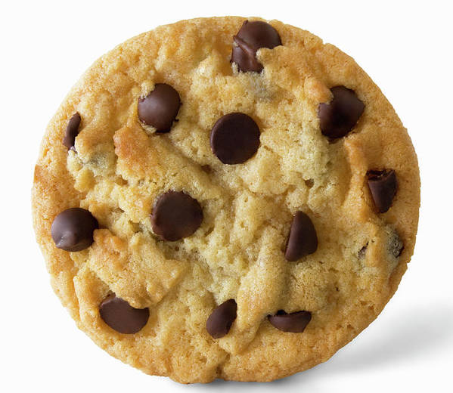
Same or Different?
What do you notice is the same about these pictures? What do you notice is different?

Slide 2
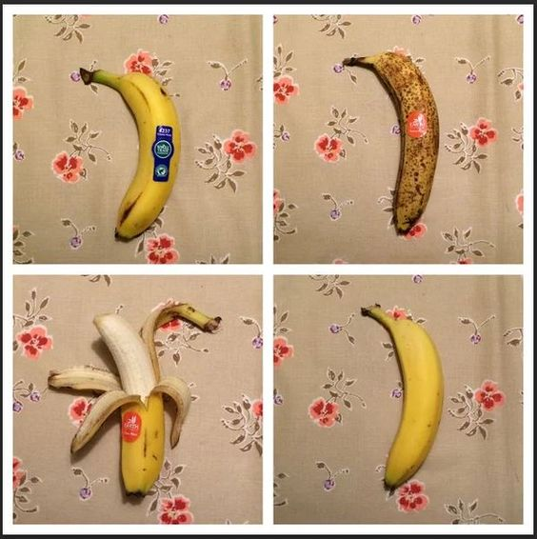
Which one doesn’t belong?
Why?

Slide 3
Same or Different?
What do you notice is the same about these pictures? What do you notice is different?

Slide 4
Same or Different?
What do you notice is the same about these pictures? What do you notice is different?

Slide 5
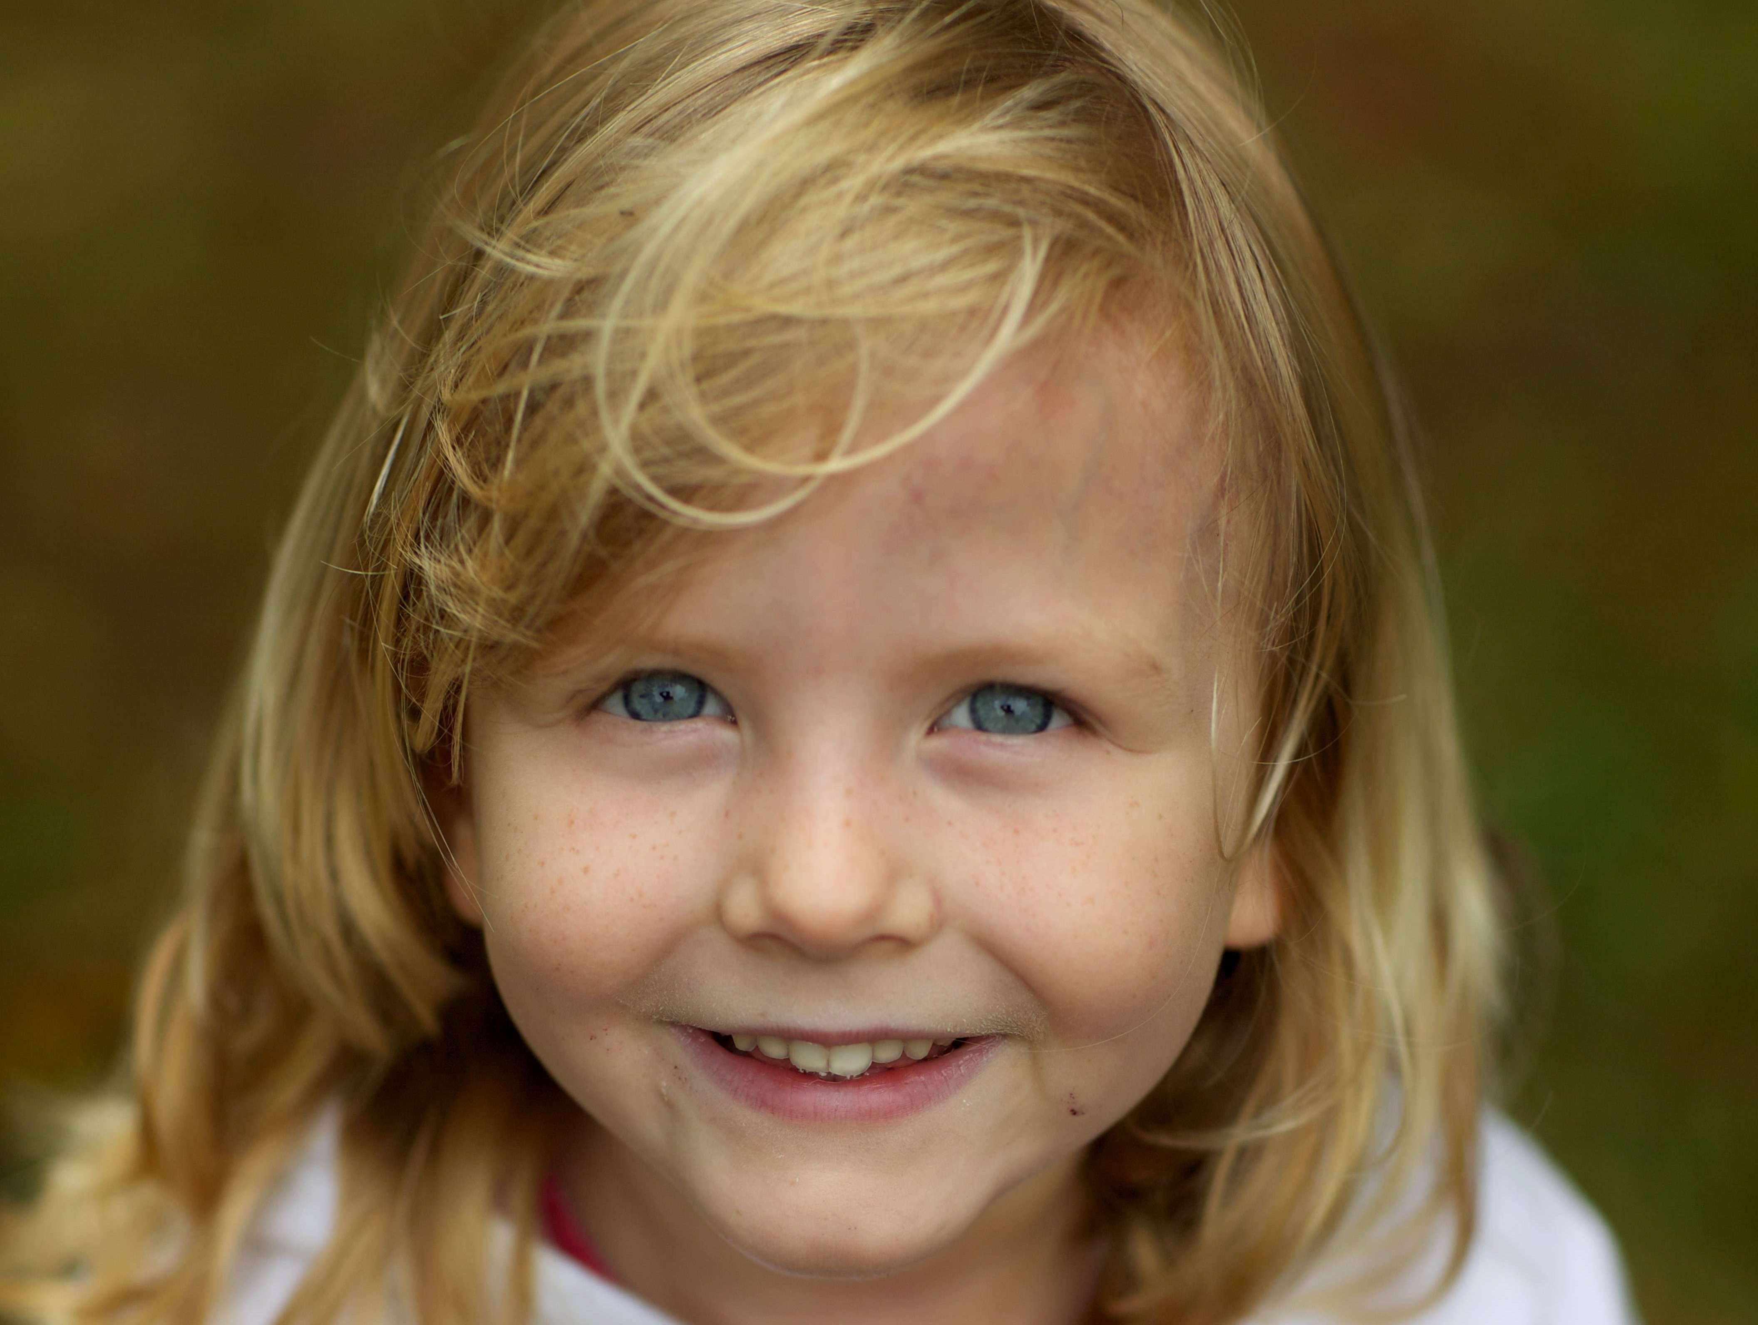
Where do we see one?
Encourage students to be very specific.

