Slide 1
What do you notice?
What do you wonder?
How many?
How do you see it?

Slide 2
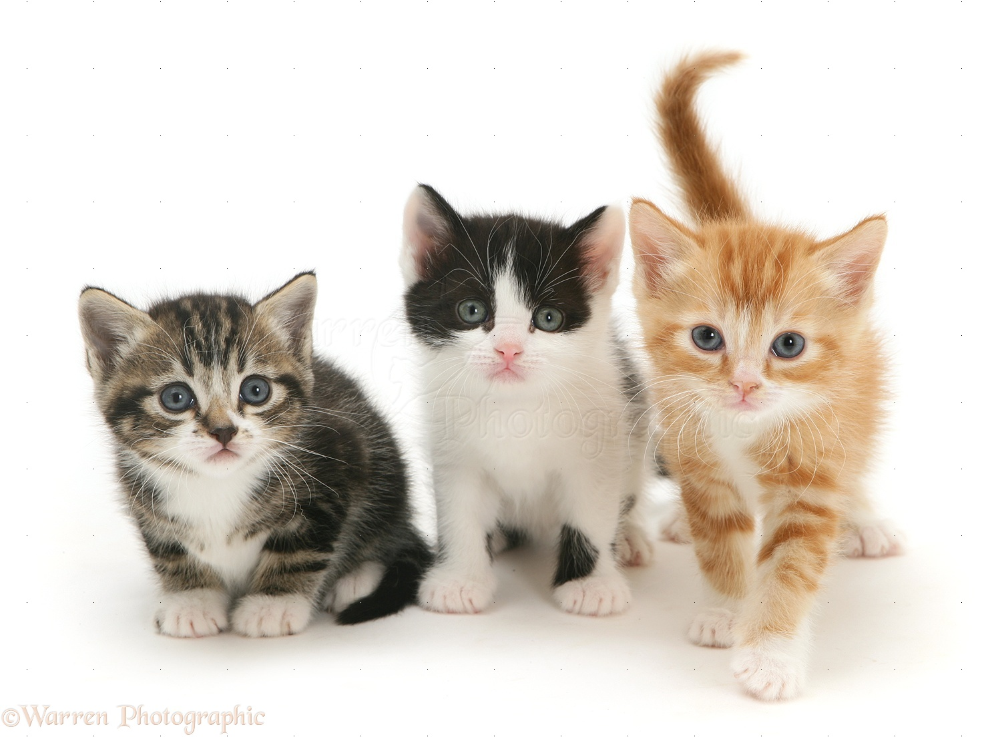
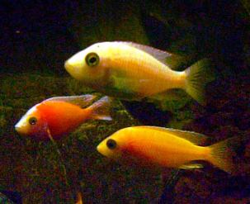
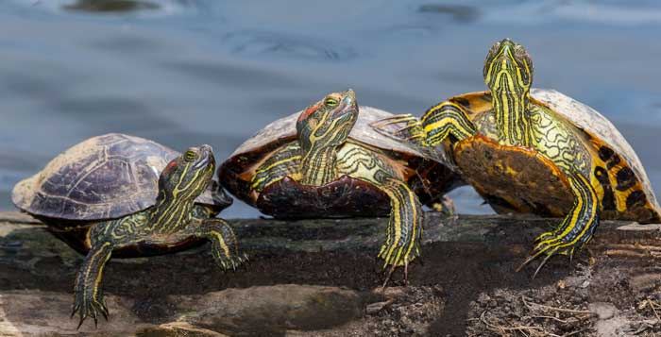
Same or Different?
What do you notice is the same about these pictures? What do you notice is different?

Slide 3
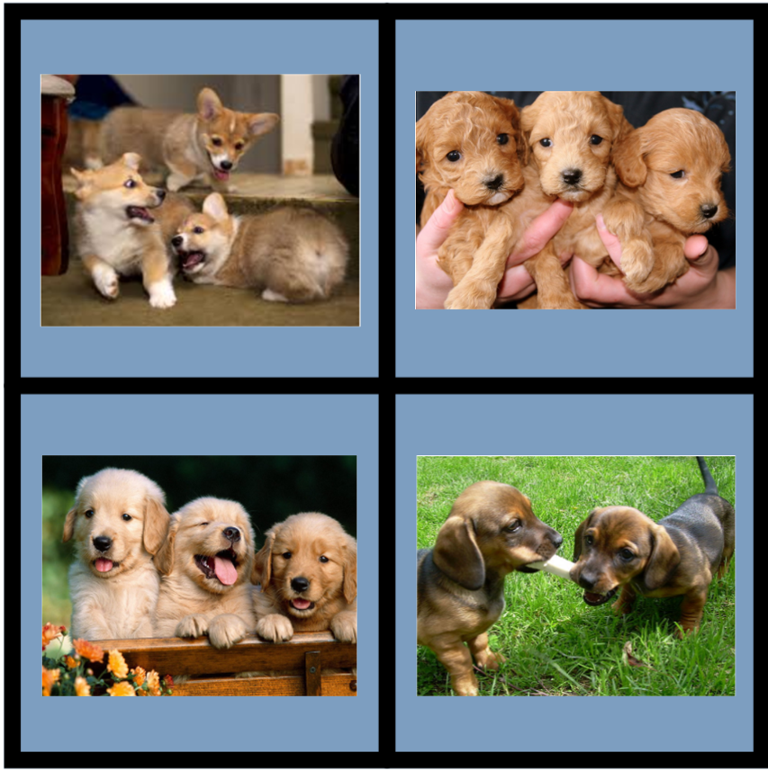
Which one doesn't belong? Why?

Slide 4
Which one doesn't belong? Why?

Slide 5
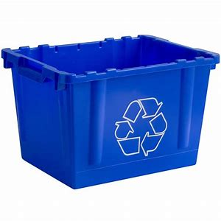
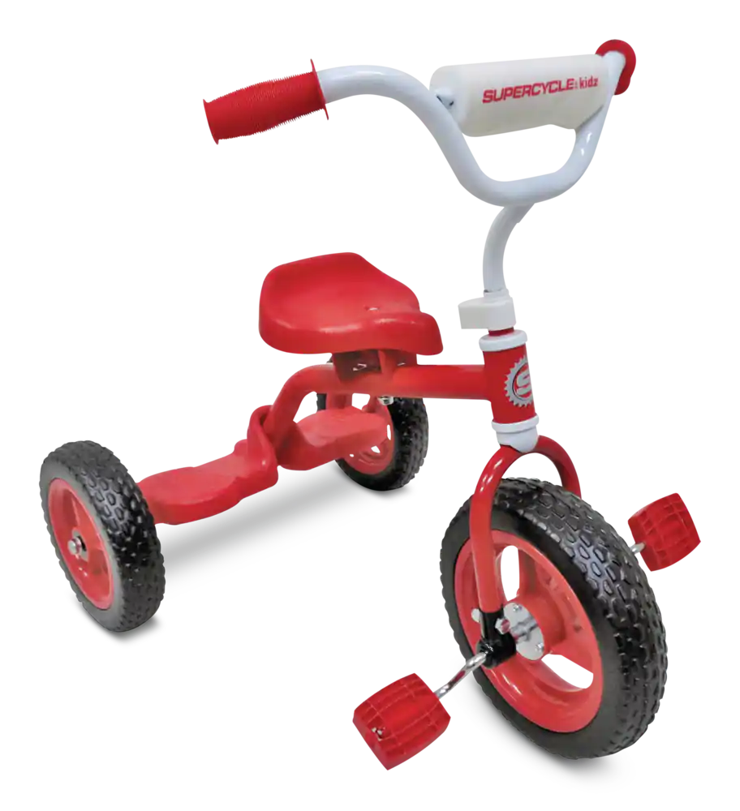
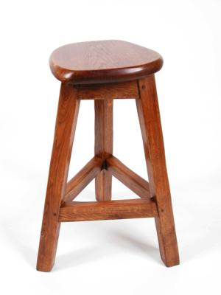
Where do we see three? Encourage students to be very specific.

Slide 6
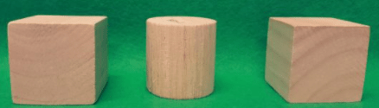
What do you notice?
What do you wonder?
How many?
How do you see it?

Slide 7
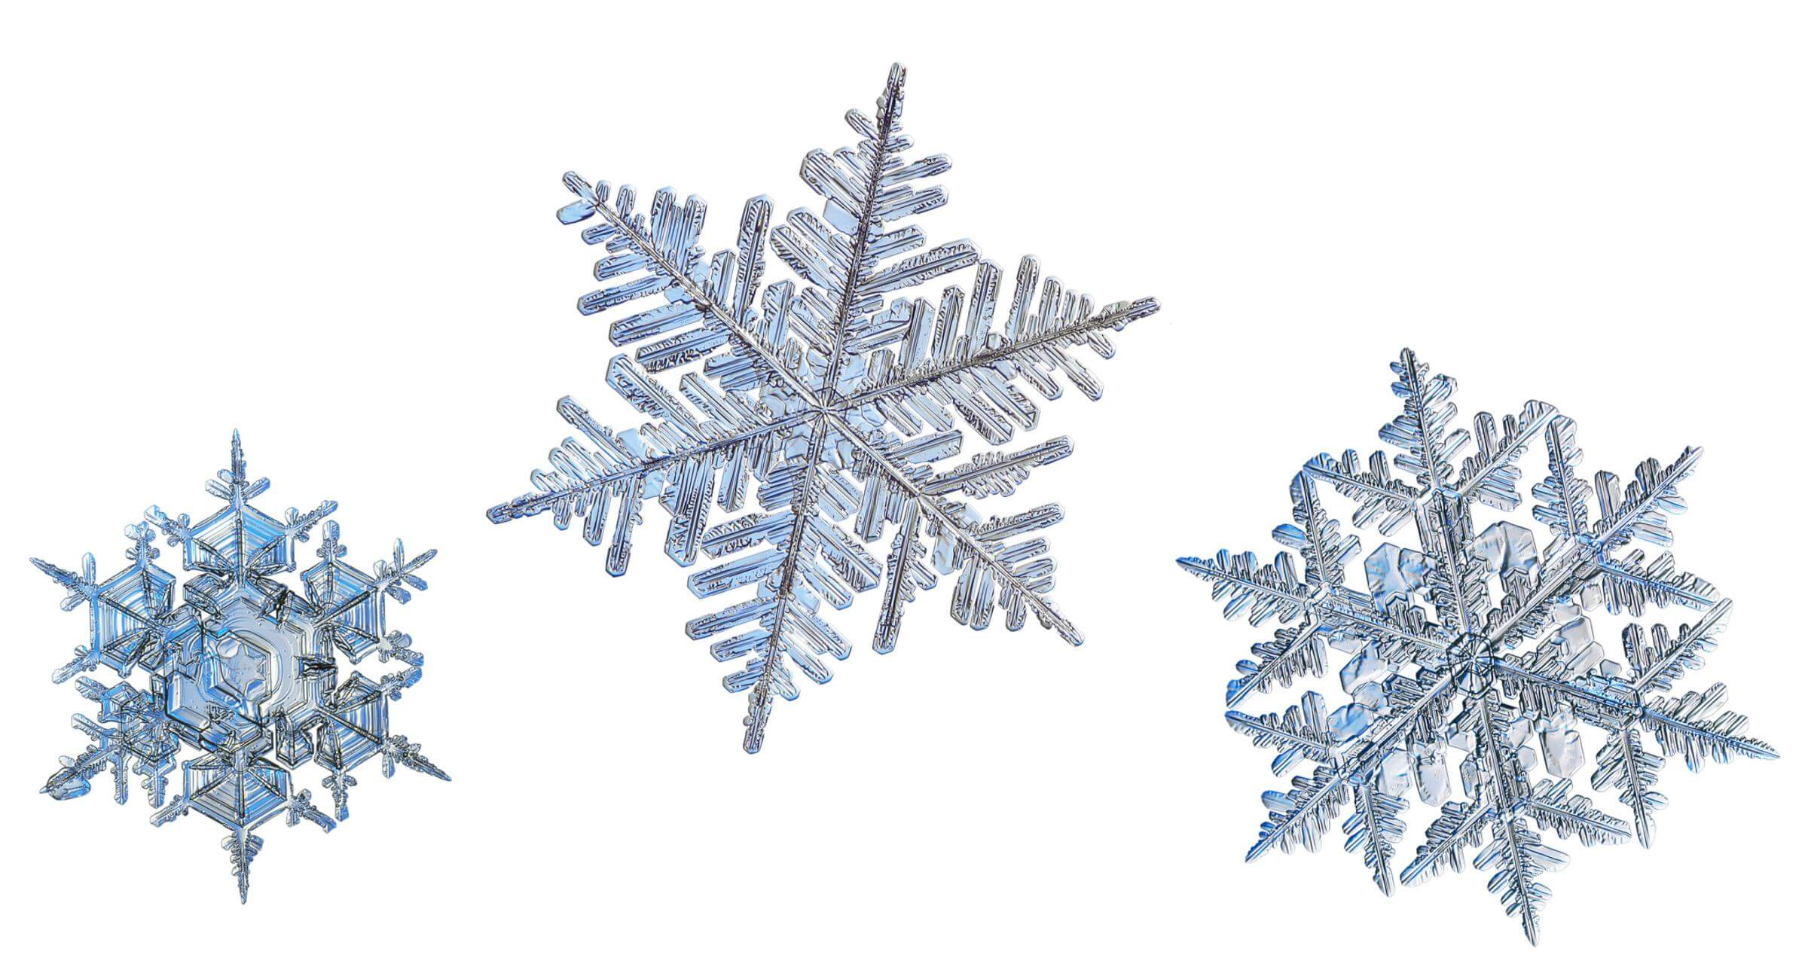
What do you notice?
What do you wonder?
How many?
How do you see it?

Slide 8
What do you notice?
What do you wonder?
How many?
How do you see it?

Slide 9
What do you notice?
What do you wonder?
How many?
How do you see it?

Slide 10
What do you notice?
What do you wonder?

Slide 11
What do you notice?
What do you wonder?
How many?
How do you see it?

Slide 12
What do you notice?
What do you wonder?
How many?
How do you see it?

Slide 13
What do you notice?
What do you wonder?
How many?
How do you see it?

