Slide 1
Same or Different?
What do you notice is the same about these pictures? What do you notice is different?

Slide 2
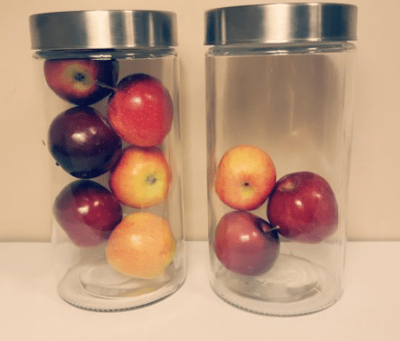
What do you notice? ​
What do you wonder? ​
How many? ​
How do you see it?​

Slide 3
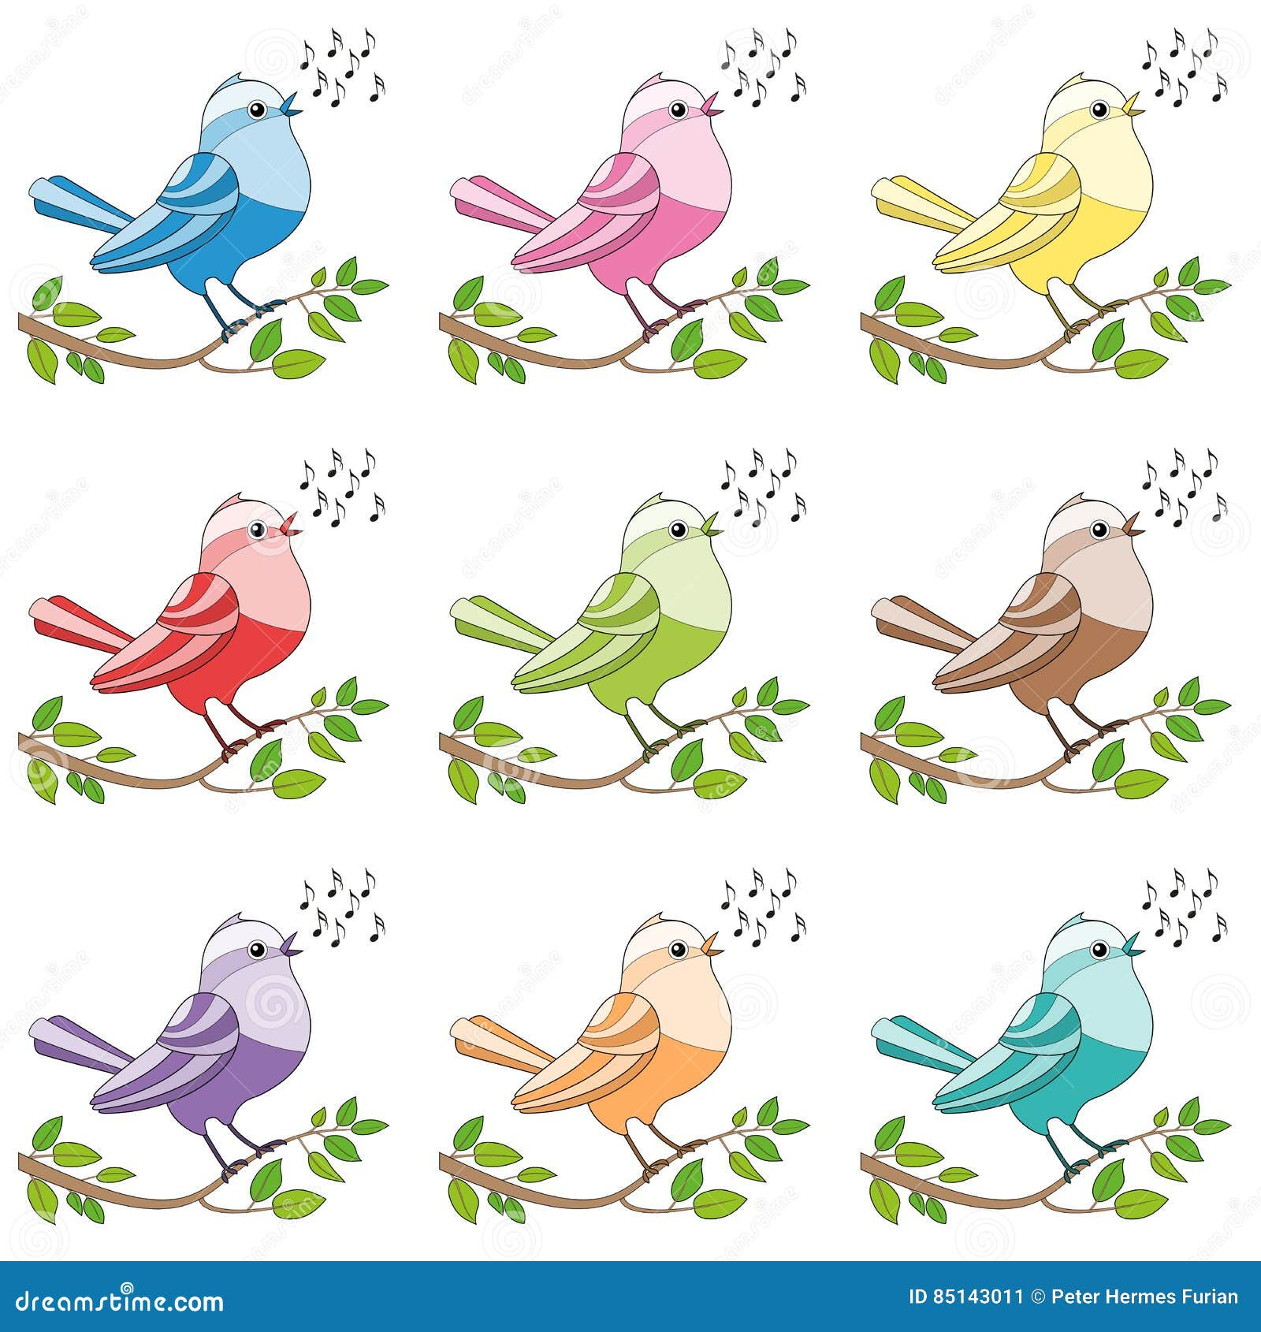
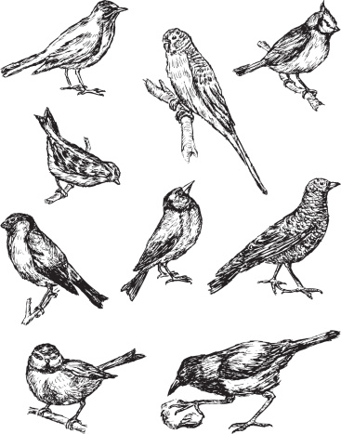
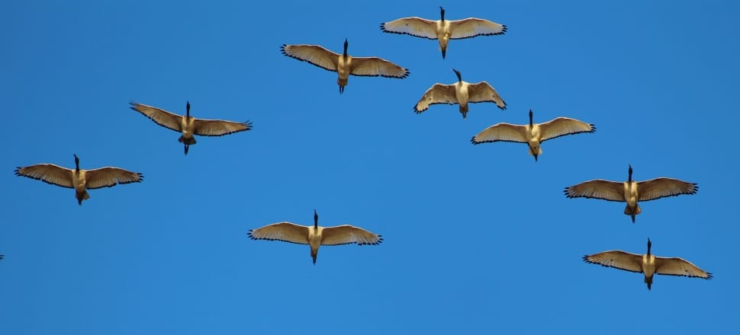
Which one of these pictures doesn't belong?
Why?
1
2
3
4

Slide 4
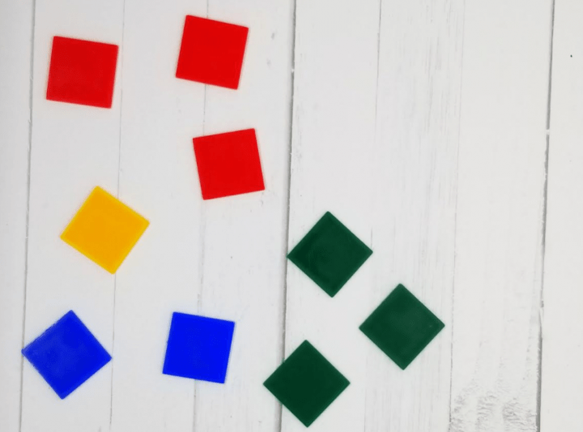
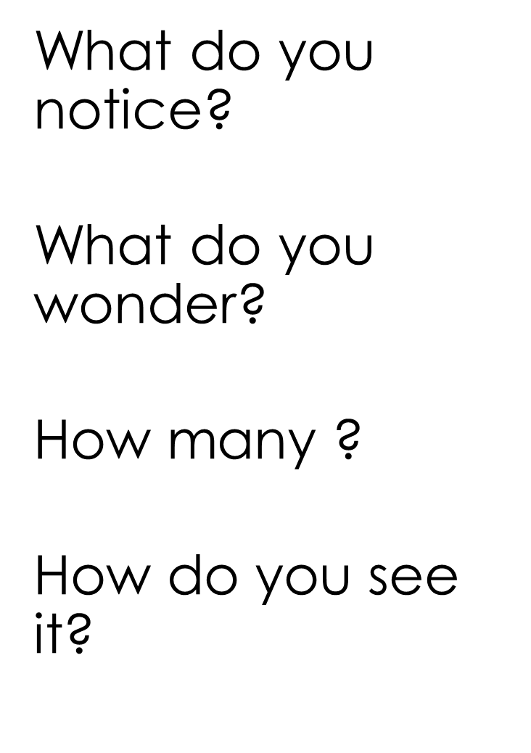

Slide 5
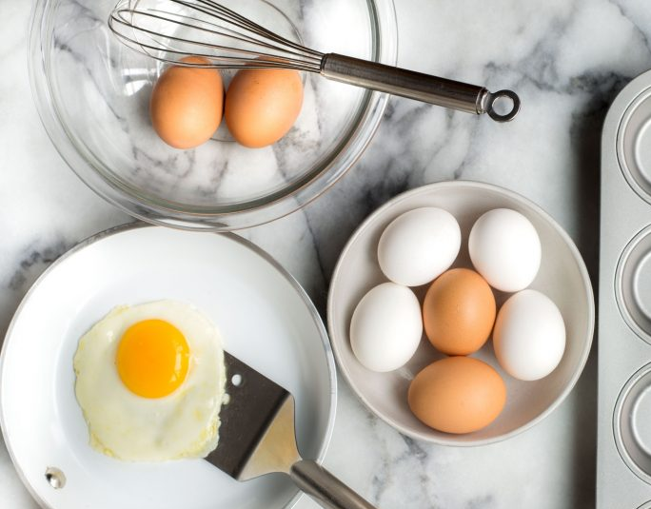
What do you notice? ​
What do you wonder? ​
How many? ​
How do you see it?​

Slide 6
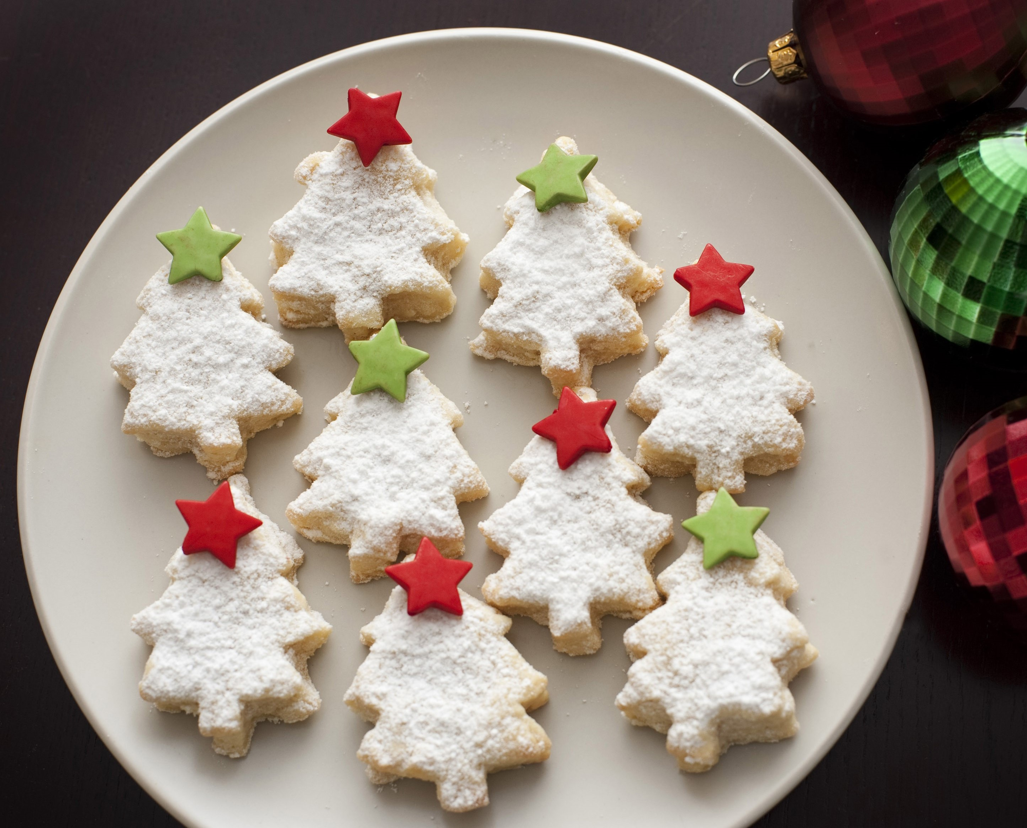
What do you notice? ​
What do you wonder? ​
How many? ​
How do you See it?​

Slide 7
What do you notice? ​
What do you wonder? ​
How many? ​
How do you see it?​

