Slide 1
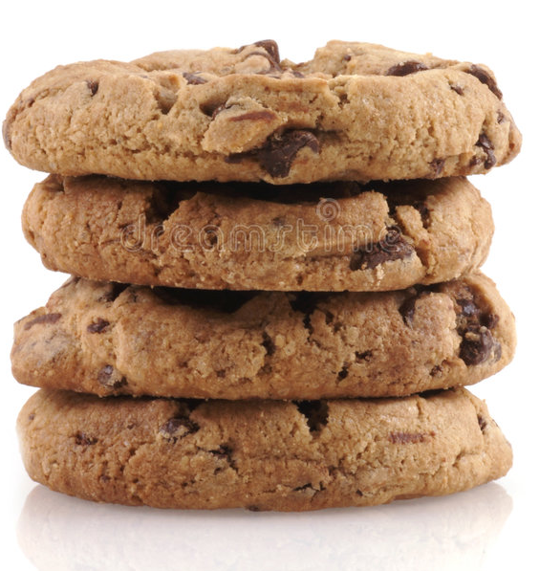
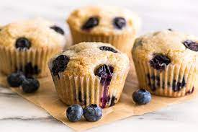
Same or Different?
What do you notice is the same about these pictures? What do you notice is different?

Slide 2
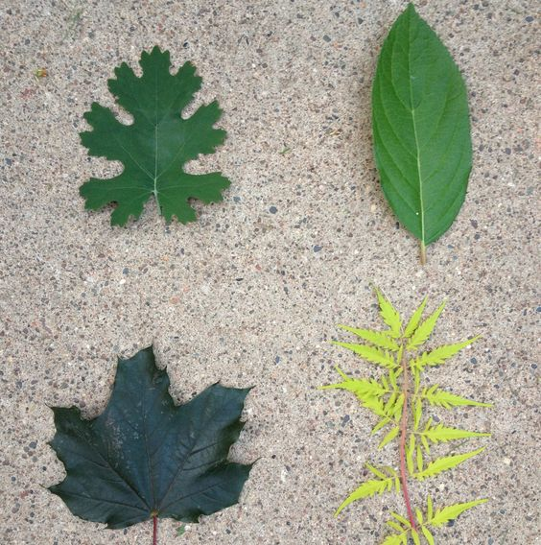
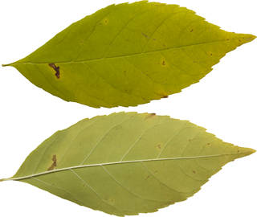
Which one of these pictures doesn't belong?
Why?
1
2
3
4

Slide 3
What do you notice?
What do you wonder?
How many?
How do you see it?

Slide 4
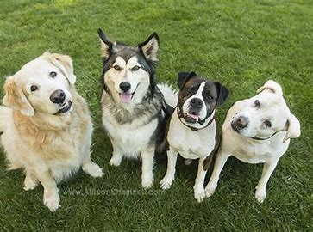
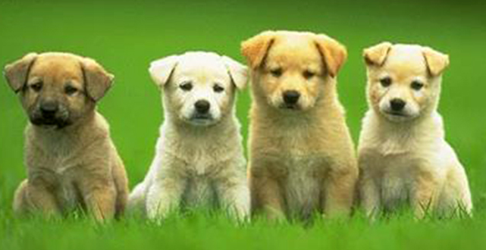
Same or Different?
What do you notice is the same about these pictures? What do you notice is different?

Slide 5
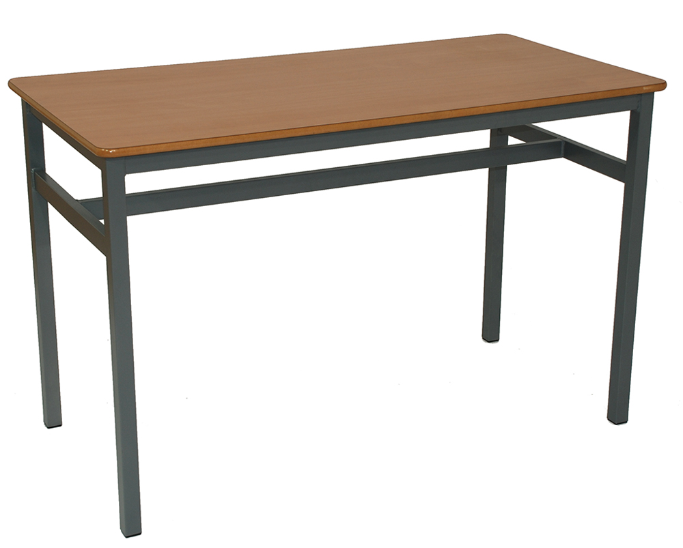
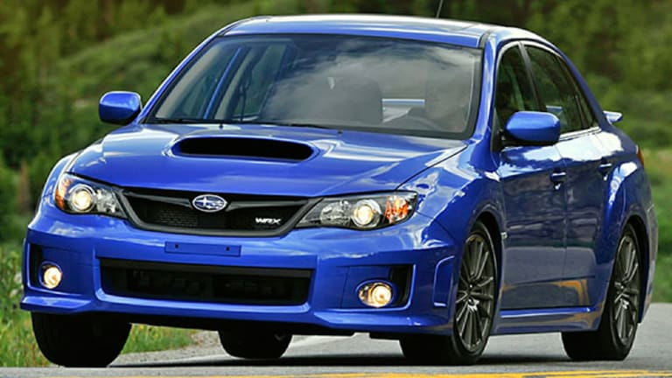
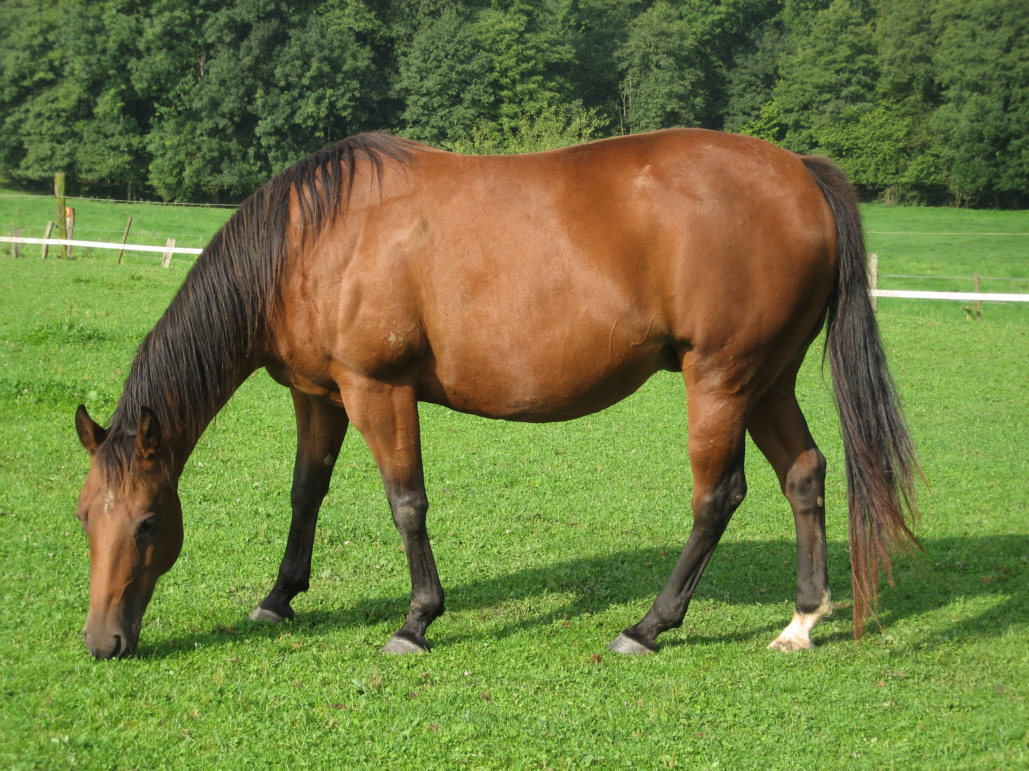
Where do we see four? Encourage students to be very specific.

Slide 6
Same or Different?
What do you notice is the same about these pictures? What do you notice is different?

Slide 7
Which one doesn't belong?
Why?

Slide 8
What do you notice?
What do you wonder?
How many?
How do you see it?

Slide 9
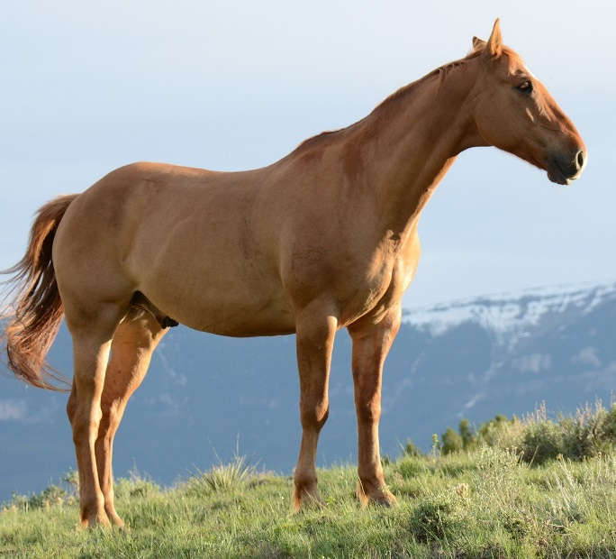
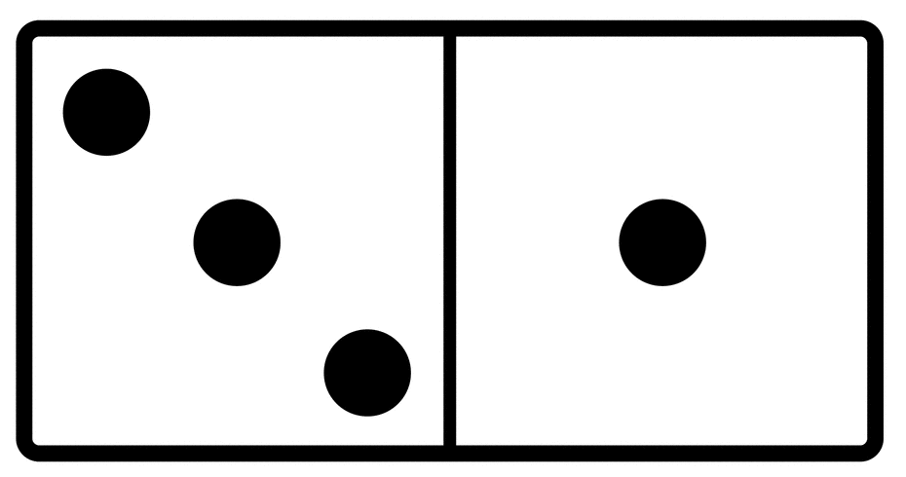
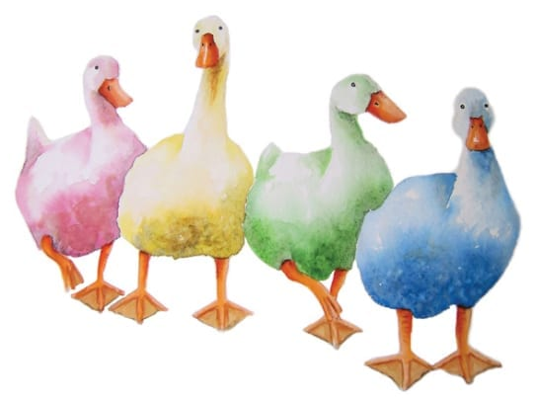
Same or Different?
What do you notice is the same about these pictures? What do you notice is different?

Slide 10
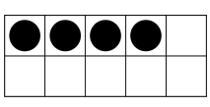
Same or Different?
What do you notice is the same about these pictures? What do you notice is different?

Slide 11
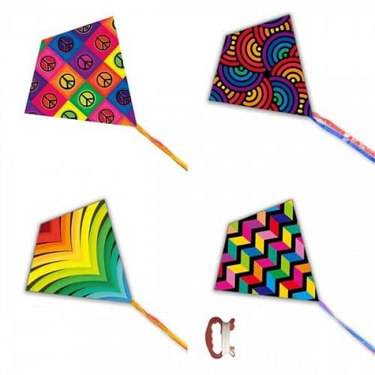
What do you notice?
What do you wonder?
How many?
How do you see it?

