Slide 1
I Have, You Need

Slide 2
I have, you need…”
This simple routine works on decomposition, strengthens quick facts. Teacher can use specific target numbers to increase practice of certain concepts ( e.g. ways to make ten) You can see this routine in action here - I Have, You Need (mathisfigureoutable.com)
Materials:
Lap Whiteboards
Whiteboard pens
PowerPoint or use large whiteboard to display target.
The aim is to make the target number:
Teacher chooses a Target number and displays it on board (e.g. 10)
Teacher says “I have 7, you need…”
Students record the number they need to make the target amount on their whiteboard.
Teacher prompts students to use strategies and names strategies as students are using them to come up with their answer.
Teacher record answers as equation on the whiteboard.

Slide 4
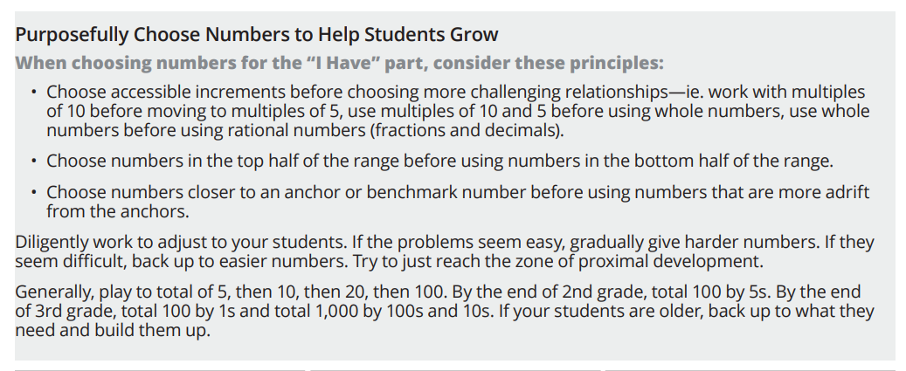

Slide 6
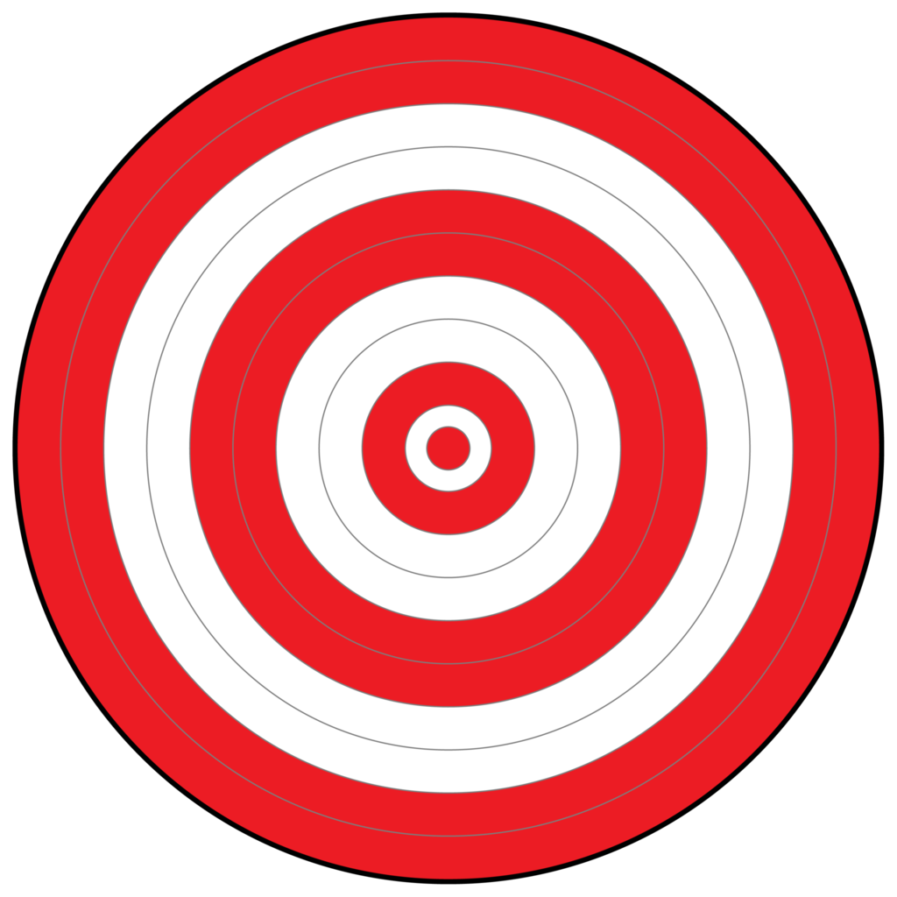
I have 3, you need…
3
I have 1, you need…
I have 2, you need…
Notes:
Teacher records an equation under each bubble
Name strategies students are using…
“How can you use your fingers to help you?

Slide 7
I have 3, you need…
I have 4, you need…
4
I have 1, you need…
I have 2, you need…
Notes:
Teacher records an equation under each bubble
Name strategies students are using…
“How can you use your fingers to help you?

Slide 8
I have 4, you need…
I have 2, you need…
I have 3, you need…
5
I have 1, you need…
I have 5, you need…
Notes:
Teacher records an equation under each bubble
Name strategies students are using…
“How can you use your fingers to help you?

Slide 9
I have 4, you need…
I have 2, you need…
I have 3, you need…
6
I have 1, you need…
I have 5, you need…
Notes:
Teacher records an equation under each bubble
Name strategies students are using…
“How can you use your fingers to help you?

Slide 10
I have 5, you need…
I have 6, you need…
I have 3, you need…
7
I have 4, you need…
I have 1, you need…
Notes:
Teacher records an equation under each bubble
Name strategies students are using…
“How can you use your fingers to help you?

Slide 11
I have 1, you need…
I have 5, you need…
I have 6, you need…
8
I have 4, you need…
I have 8, you need…
Notes:
Teacher records an equation under each bubble
Name strategies students are using…
“How can you use your fingers to help you?

Slide 12
I have 3, you need…
I have 2, you need…
I have 6, you need…
9
I have 4, you need…
I have 8, you need…
Notes:
Teacher record an equation under each bubble
Name strategies students are using…
“How can you use your fingers to help you?

Slide 13
I have 9, you need…
I have 7, you need…
I have 5, you need…
10
I have 4, you need…
I have 8, you need…
Notes:
Teacher record an equation under each bubble
Name strategies students are using… “Abi knew she had 10 fingers, so she put down 8 and counted 2 left, or counted up from 8..
“How can you use your fingers to help you?

Slide 14
I have 9, you need…
I have 5, you need…
I have 6, you need…
11
I have 4, you need…
I have 10, you need…
Notes:
Teacher record an equation under each bubble
Name strategies students are using…
“How can you use your fingers to help you?

Slide 15
I have 9, you need…
I have 7, you need…
I have 5, you need…
12
I have 4, you need…
I have 8, you need…
Notes:
Teacher record an equation under each bubble
Name strategies students are using… “abi knew she had 10 fingers so she put down 8 and counted 2 left, or counted up from 8
“How can you use your fingers to help you?

Slide 16
I have 9, you need…
I have 10, you need…
I have 5, you need…
13
I have 3, you need…
I have 8, you need…
Notes:
Teacher record an equation under each bubble
Name strategies students are using… “abi knew she had 10 fingers so she put down 8 and counted 2 left, or counted up from 8
“How can you use your fingers to help you?

Slide 17
I have 9, you need…
I have 10, you need…
I have 5, you need…
14
I have 4, you need…
I have 8, you need…
Notes:
Teacher record an equation under each bubble
Name strategies students are using…

Slide 18
I have 9, you need…
I have 10, you need…
I have 5, you need…
15
I have 11, you need…
I have 12, you need…
Notes:
Teacher record an equation under each bubble
Name strategies students are using…

Slide 19
I have 9, you need…
I have 10, you need…
I have 5, you need…
16
I have 15, you need…
I have 8, you need…
Notes:
Teacher record an equation under each bubble
Name strategies students are using…
“How can you use your fingers to help you?

Slide 20
I have 9, you need…
I have 10, you need…
I have 5, you need…
16
I have 15, you need…
I have 8, you need…
Notes:
Teacher record an equation under each bubble
Name strategies students are using…
“How can you use your fingers to help you?

Slide 21
I have 7, you need…
I have 10, you need…
I have 13, you need…
17
I have 15, you need…
I have 14, you need…
Notes:
Teacher record an equation under each bubble
Name strategies students are using…
“How can you use your fingers to help you?

Slide 22
I have 8, you need…
I have 10, you need…
I have 5, you need…
18
I have 14, you need…
I have 9, you need…
Notes:
Teacher record an equation under each bubble
Name strategies students are using…
“How can you use your fingers to help you?

Slide 23
I have 5, you need…
I have 10, you need…
I have 4,
you
need…
19
I have 15, you need…
I have 9, you need…
Notes:
Teacher record an equation under each bubble
Name strategies students are using…
“How can you use your fingers to help you? How does it help to know “friends of ten” facts when working with bigger numbers?

Slide 24
I have 5, you need…
I have 10, you need…
I have 15, you need…
20
I have 13, you need…
I have 19, you need…
Notes:
Teacher record an equation under each bubble
Name strategies students are using…
“How can you use your fingers to help you? How does it help to know “friends of ten” facts when working with bigger numbers?

Slide 25
I have 10, you need…
I have 22, you need…
I have 25, you need…
30
I have 26, you need…
I have 19, you need…
Notes:
Teacher record an equation under each bubble
Name strategies students are using…
“How can you use your fingers to help you? How does it help to know “friends of ten” facts when working with bigger numbers?

Slide 26
I have, you need…
I have, you need…
I have, you need…
I have, you need…
I have, you need…
Notes:
Create your own target with this slide. Fill in the bubbles to meet the needs of your classroom.

