Slide 1
What do you notice?
What do you wonder?
How many?
How do you see it?

Slide 2
Same or Different?
What do you notice is the same about these pictures? What do you notice is different?

Slide 3
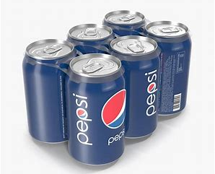
Where do we see six?
Encourage the students to be very specific.

Slide 4
What do you notice?
What do you wonder?
How many?
How do you see it?

Slide 5
What do you notice?
What do you wonder?
How many?
How do you see it?

Slide 6
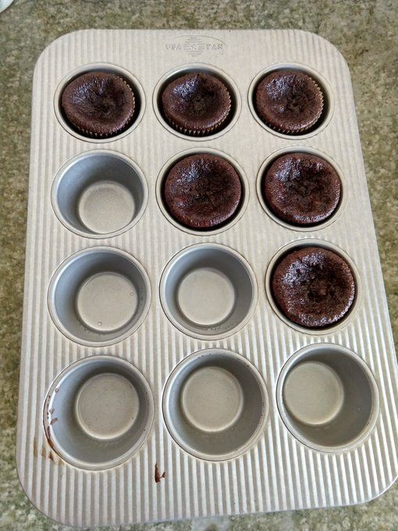
What do you notice?
What do you wonder?
How many?
How do you see it?

Slide 7
What do you notice?
What do you wonder?
How many?
How do you see it?

Slide 8
What do you notice?
What do you wonder?
How many?
How do you see it?

Slide 9
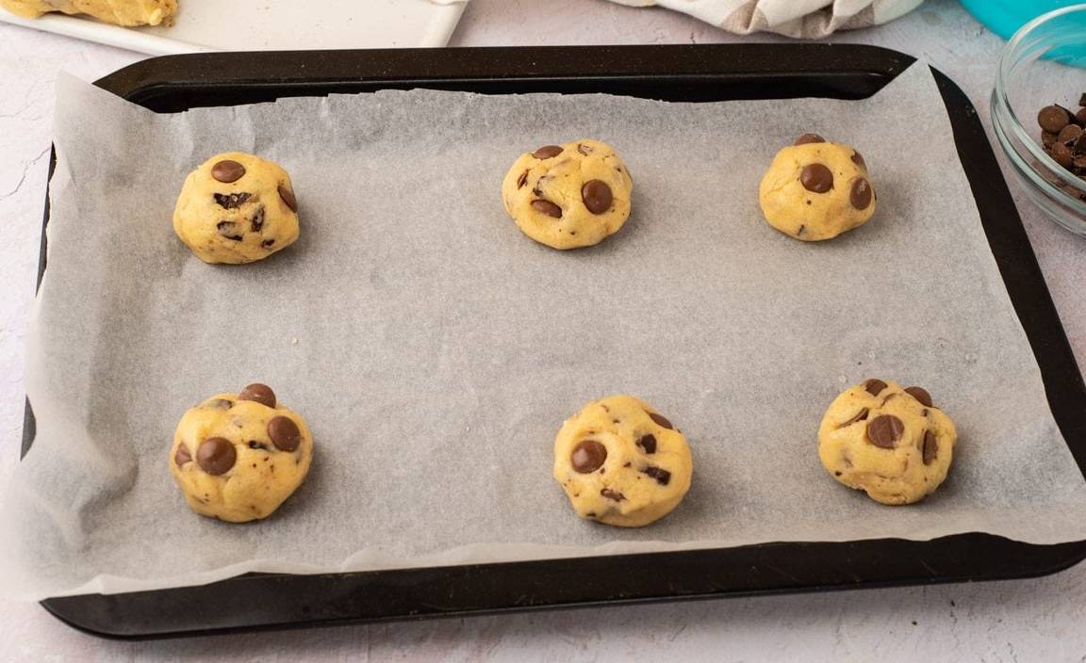
What do you notice?
What do you wonder?
How many?
How do you see it?

