Slide 1
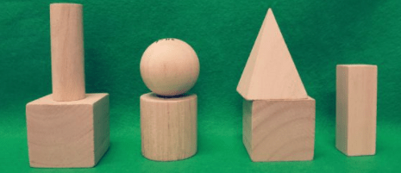
What do you notice?
What do you wonder?
How many?
How do you see it?

Slide 2
Same or Different?
What do you notice is the same about these pictures? What do you notice is different?

Slide 3
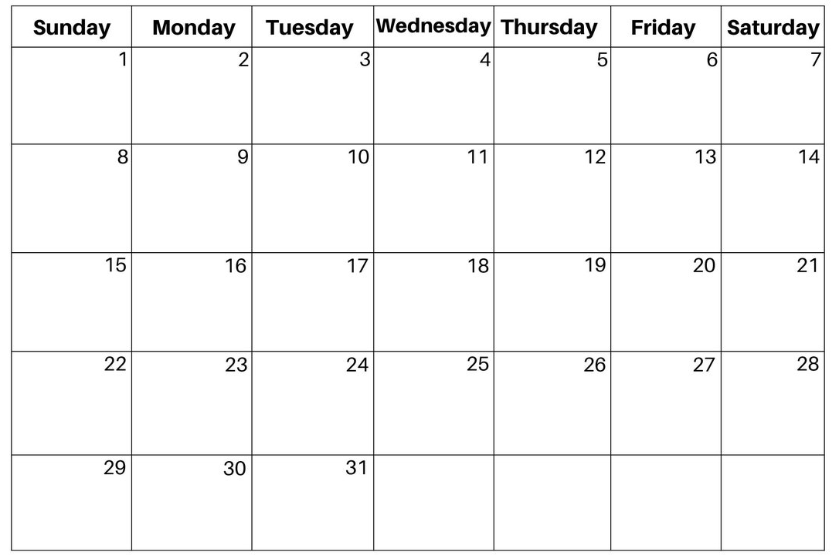
Where do we see seven?
Encourage the students to be very specific.

Slide 4
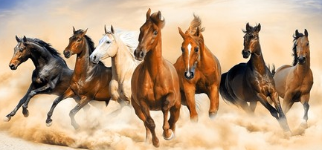
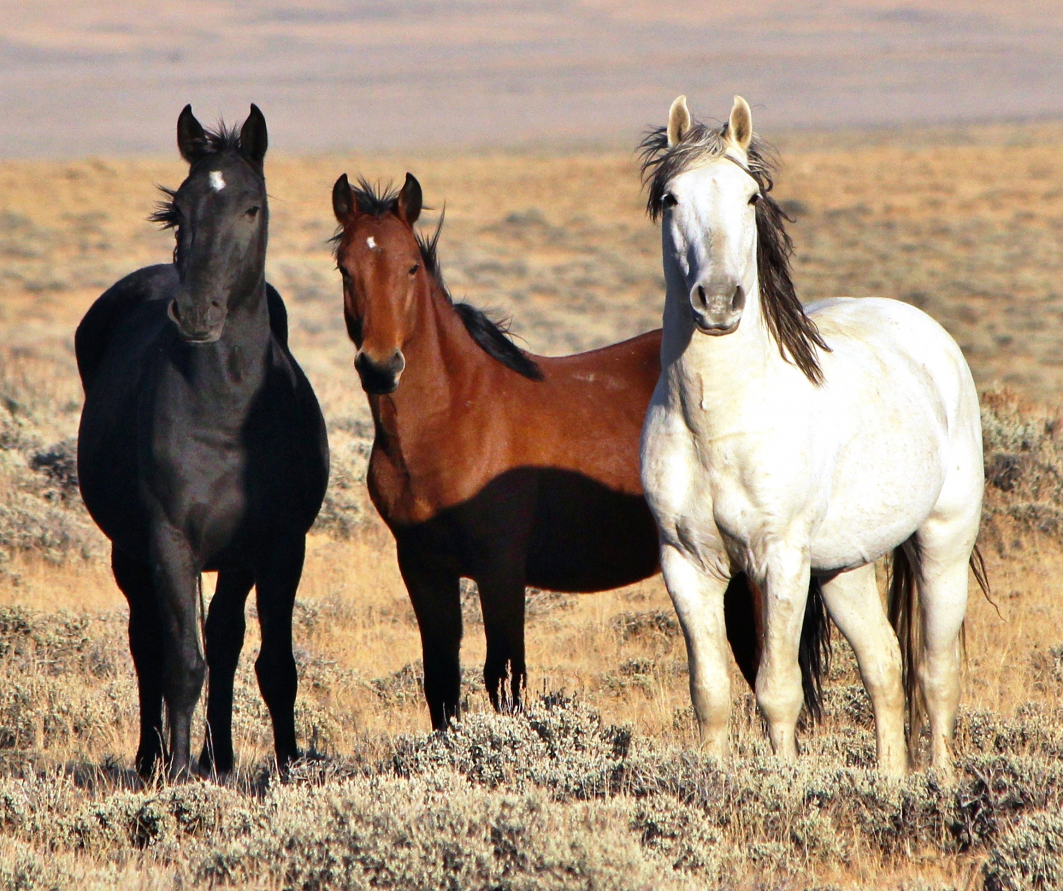
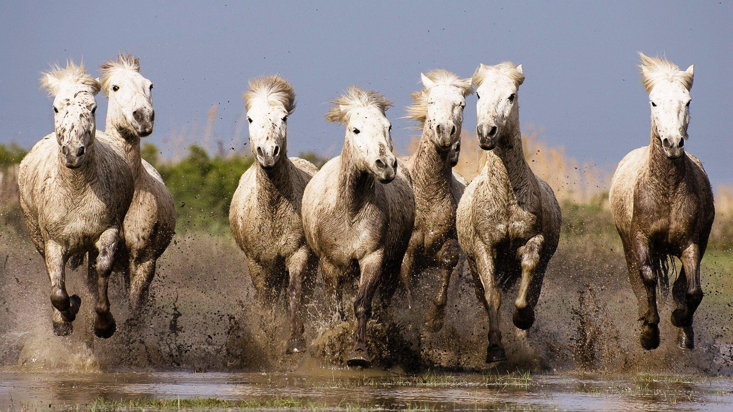
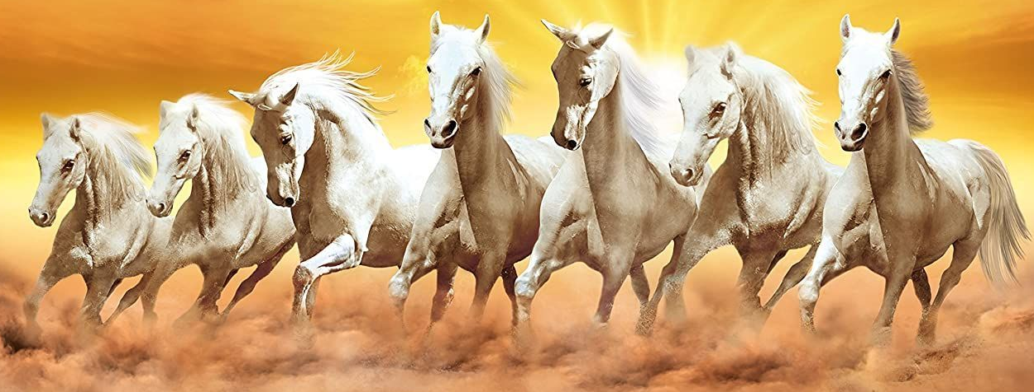
Which one of these pictures doesn't belong?
Why?
1
2
3
4

Slide 5
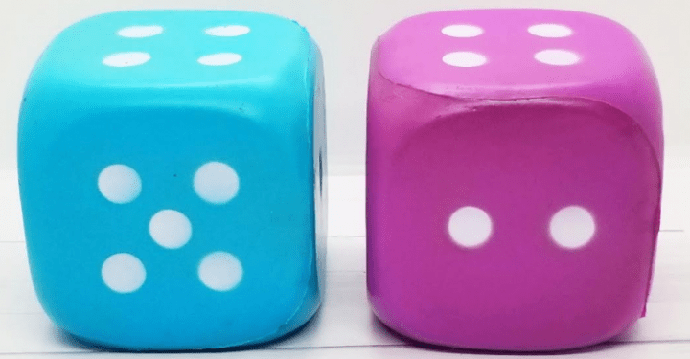
What do you notice?
What do you wonder?
How many?
How do you see it?

