Slide 1
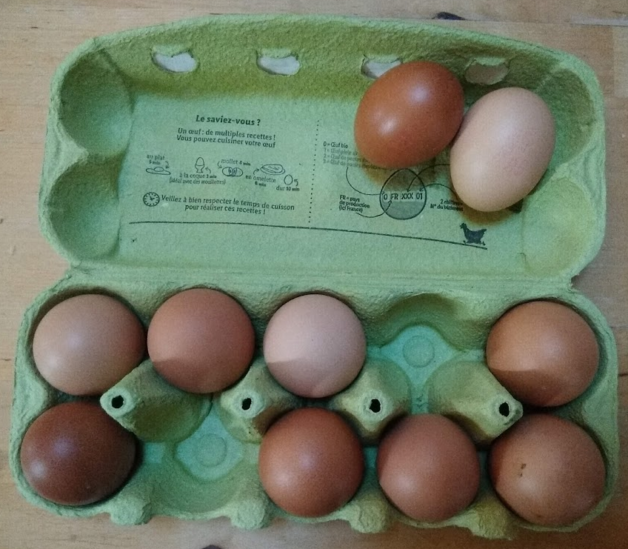
What do you notice?
What do you wonder?
How many?
How do you see it?

Slide 2
Which one of these pictures doesn't belong?
Why?
1
2
3
4

Slide 3
Same or Different?
What do you notice is the same about these pictures? What do you notice is different?
1
2
3
4

Slide 4
Ten
Which picture makes it easy to see five without counting? Why?
● | ● | ● | ● | ●
● | ● | ● | ● | ●
● | ● | ● | ●
● | ● | ●
● | ● | ●
●
● | ●
● | ● | ●
● | ● | ● | ●

Slide 5
Which one of these pictures doesn't belong?
Why?
ten
2
10
1
3
4
5+5=

Slide 6
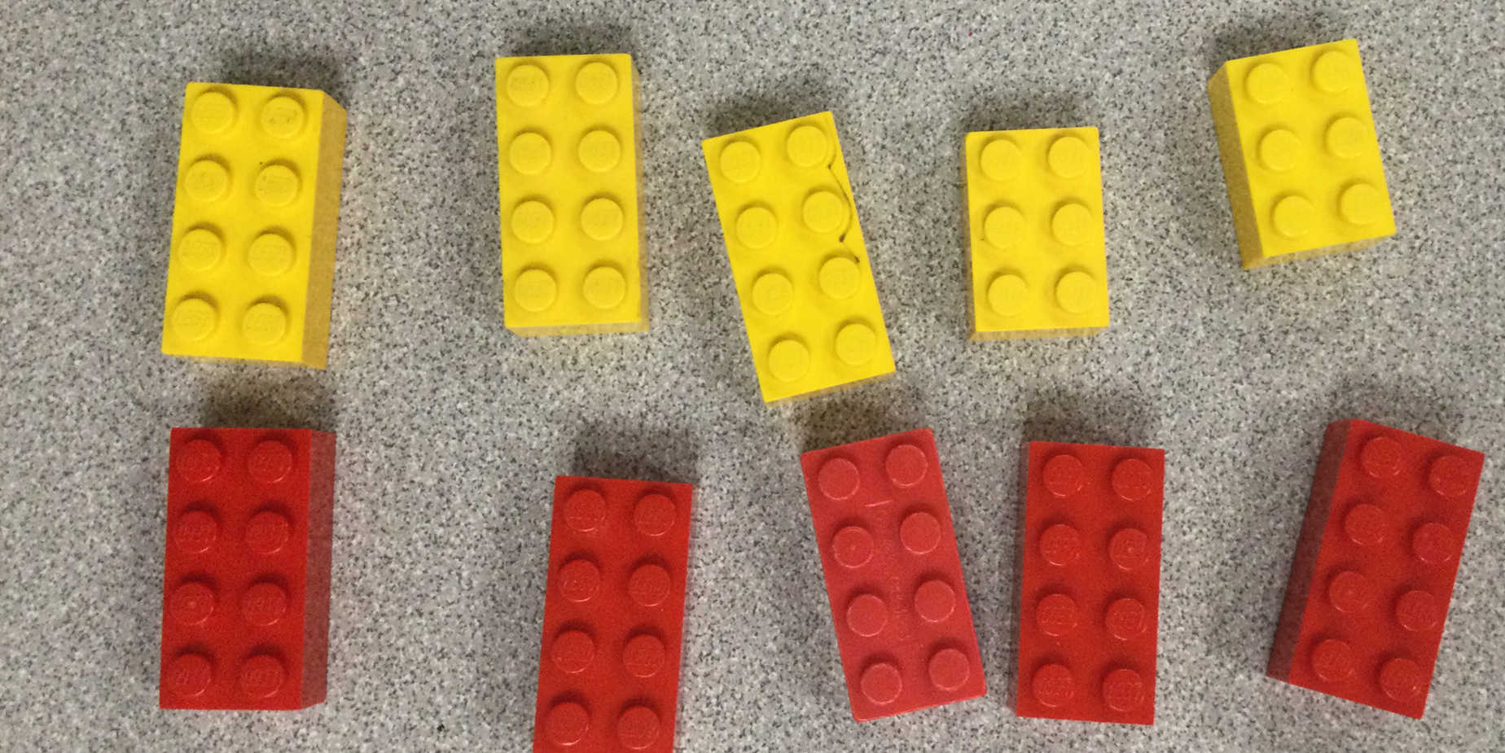
What do you notice?
What do you wonder?
How many?
How do you see it?

Slide 7
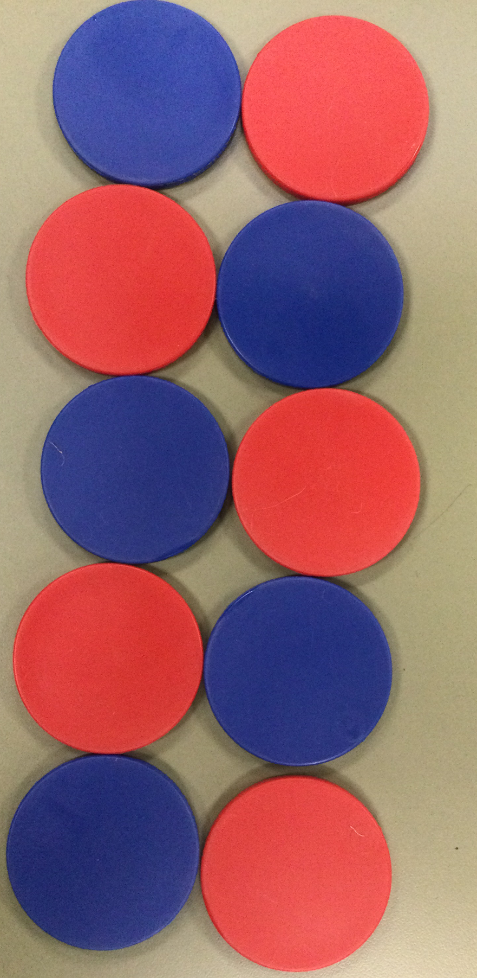
What do you notice?
What do you wonder?
How many?
How do you see it?

Slide 8
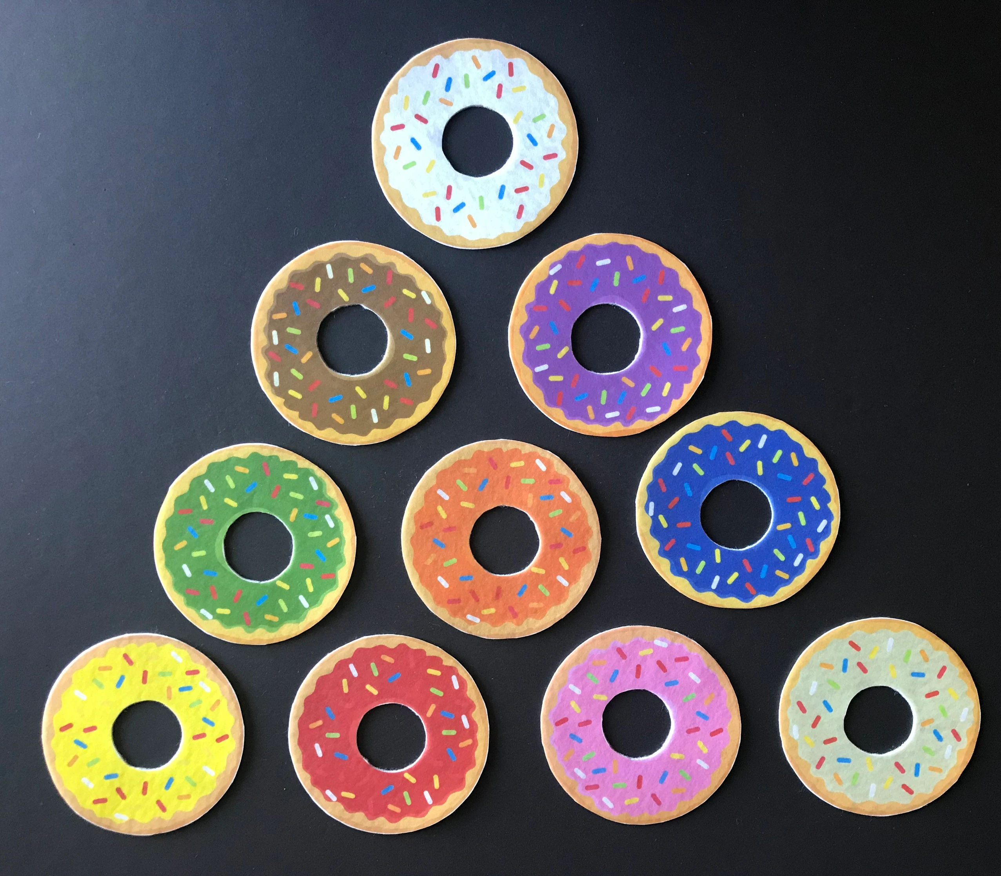
What do you notice?
What do you wonder?
How many?
How do you see it?

Slide 9
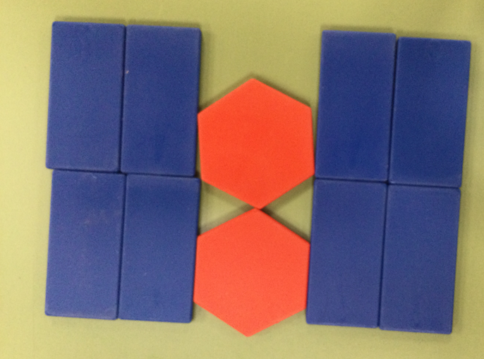
What do you notice?
What do you wonder?
How many?
How do you see it?

