Slide 1
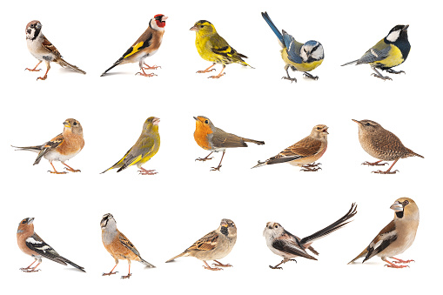
What do you notice?
What do you wonder?
How many ?
How do you see it?

Slide 2
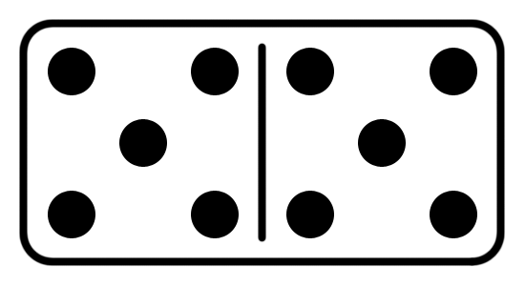
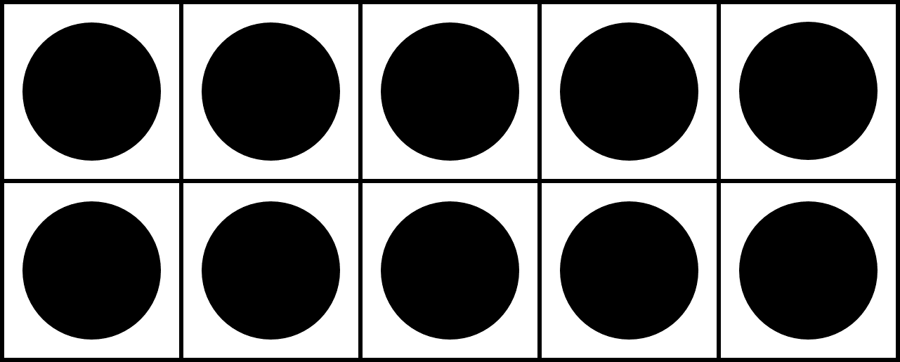
Same or Different?
What do you notice is the same about these pictures? What do you notice is different?
1
2
3
4

Slide 3
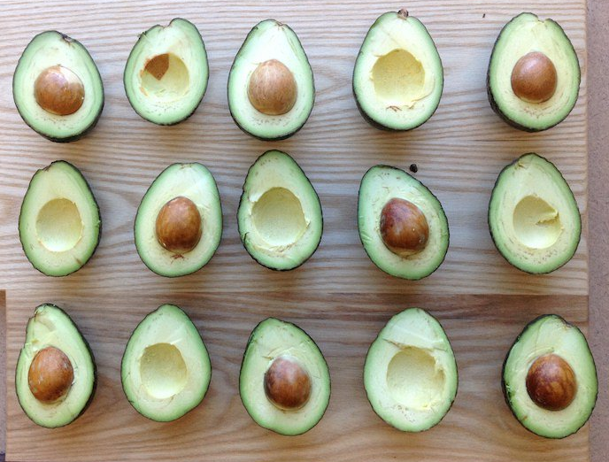
What do you notice?
What do you wonder?
How many ?
How do you see it?

Slide 4
Which one doesn’t belong?
Why?
1
2
3
4

Slide 5
How many ways can you figure out the total number of dots?

