Slide 1
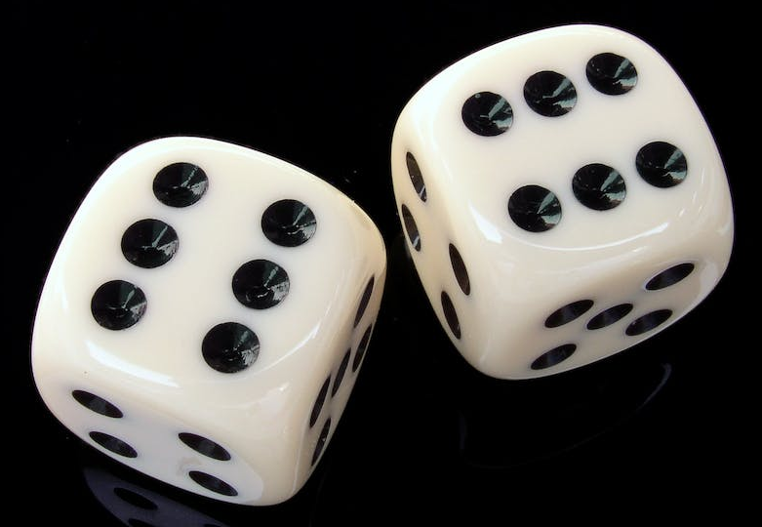
Same or Different?
What do you notice is the same about these pictures? What do you notice is different?
1
2
3
4

Slide 2
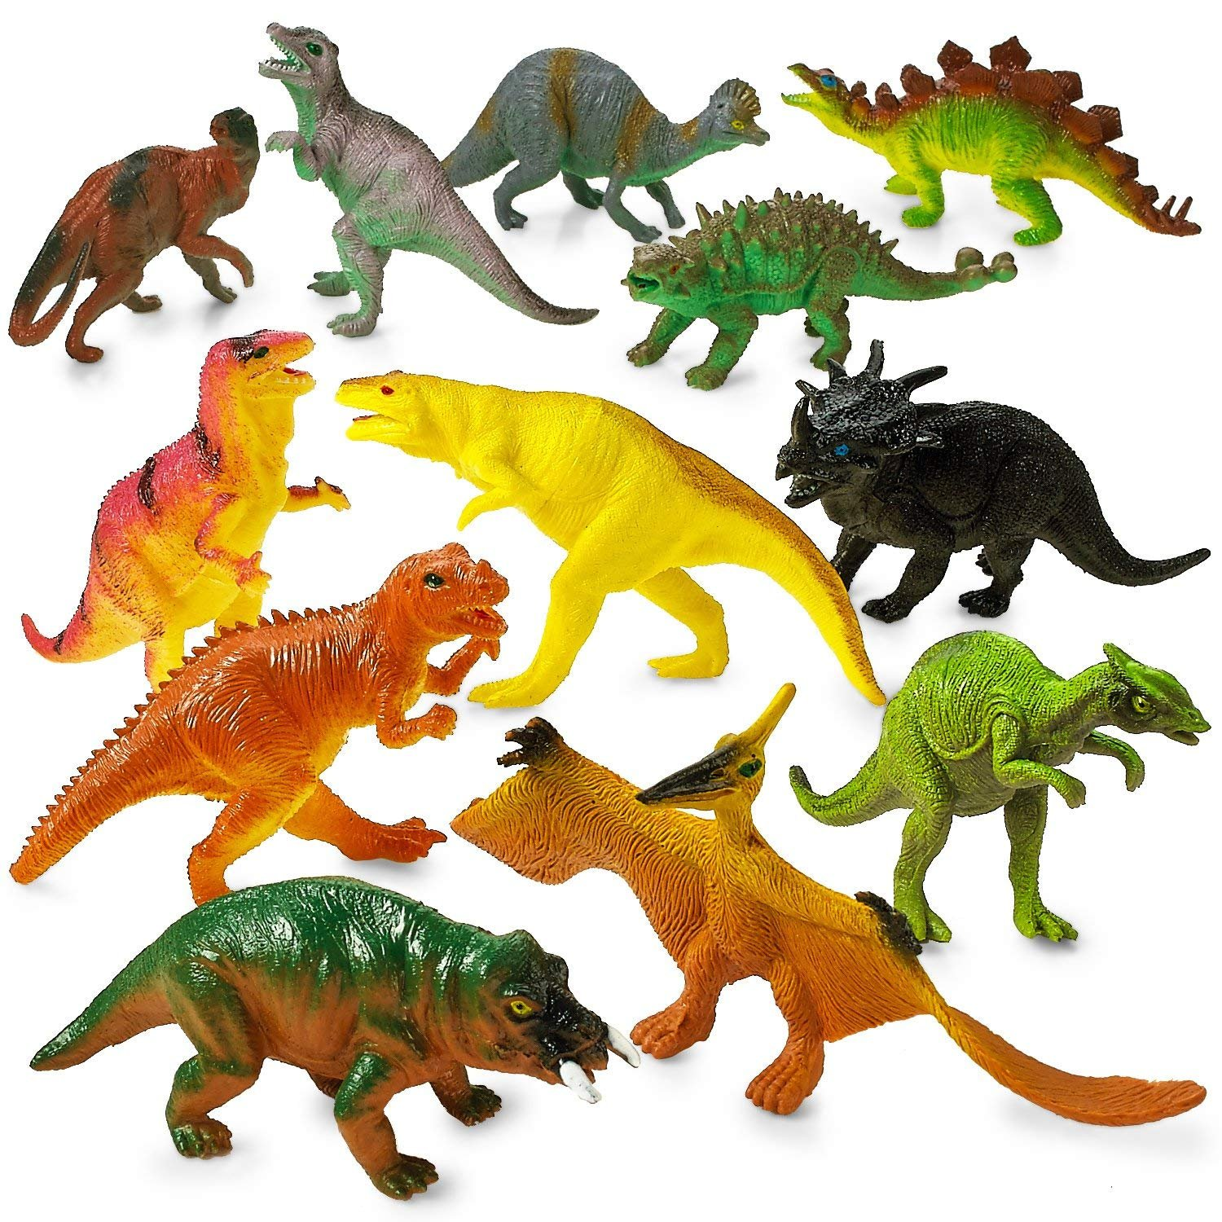
What do you notice?
What do you wonder?
How many?
How do you see it?

Slide 3
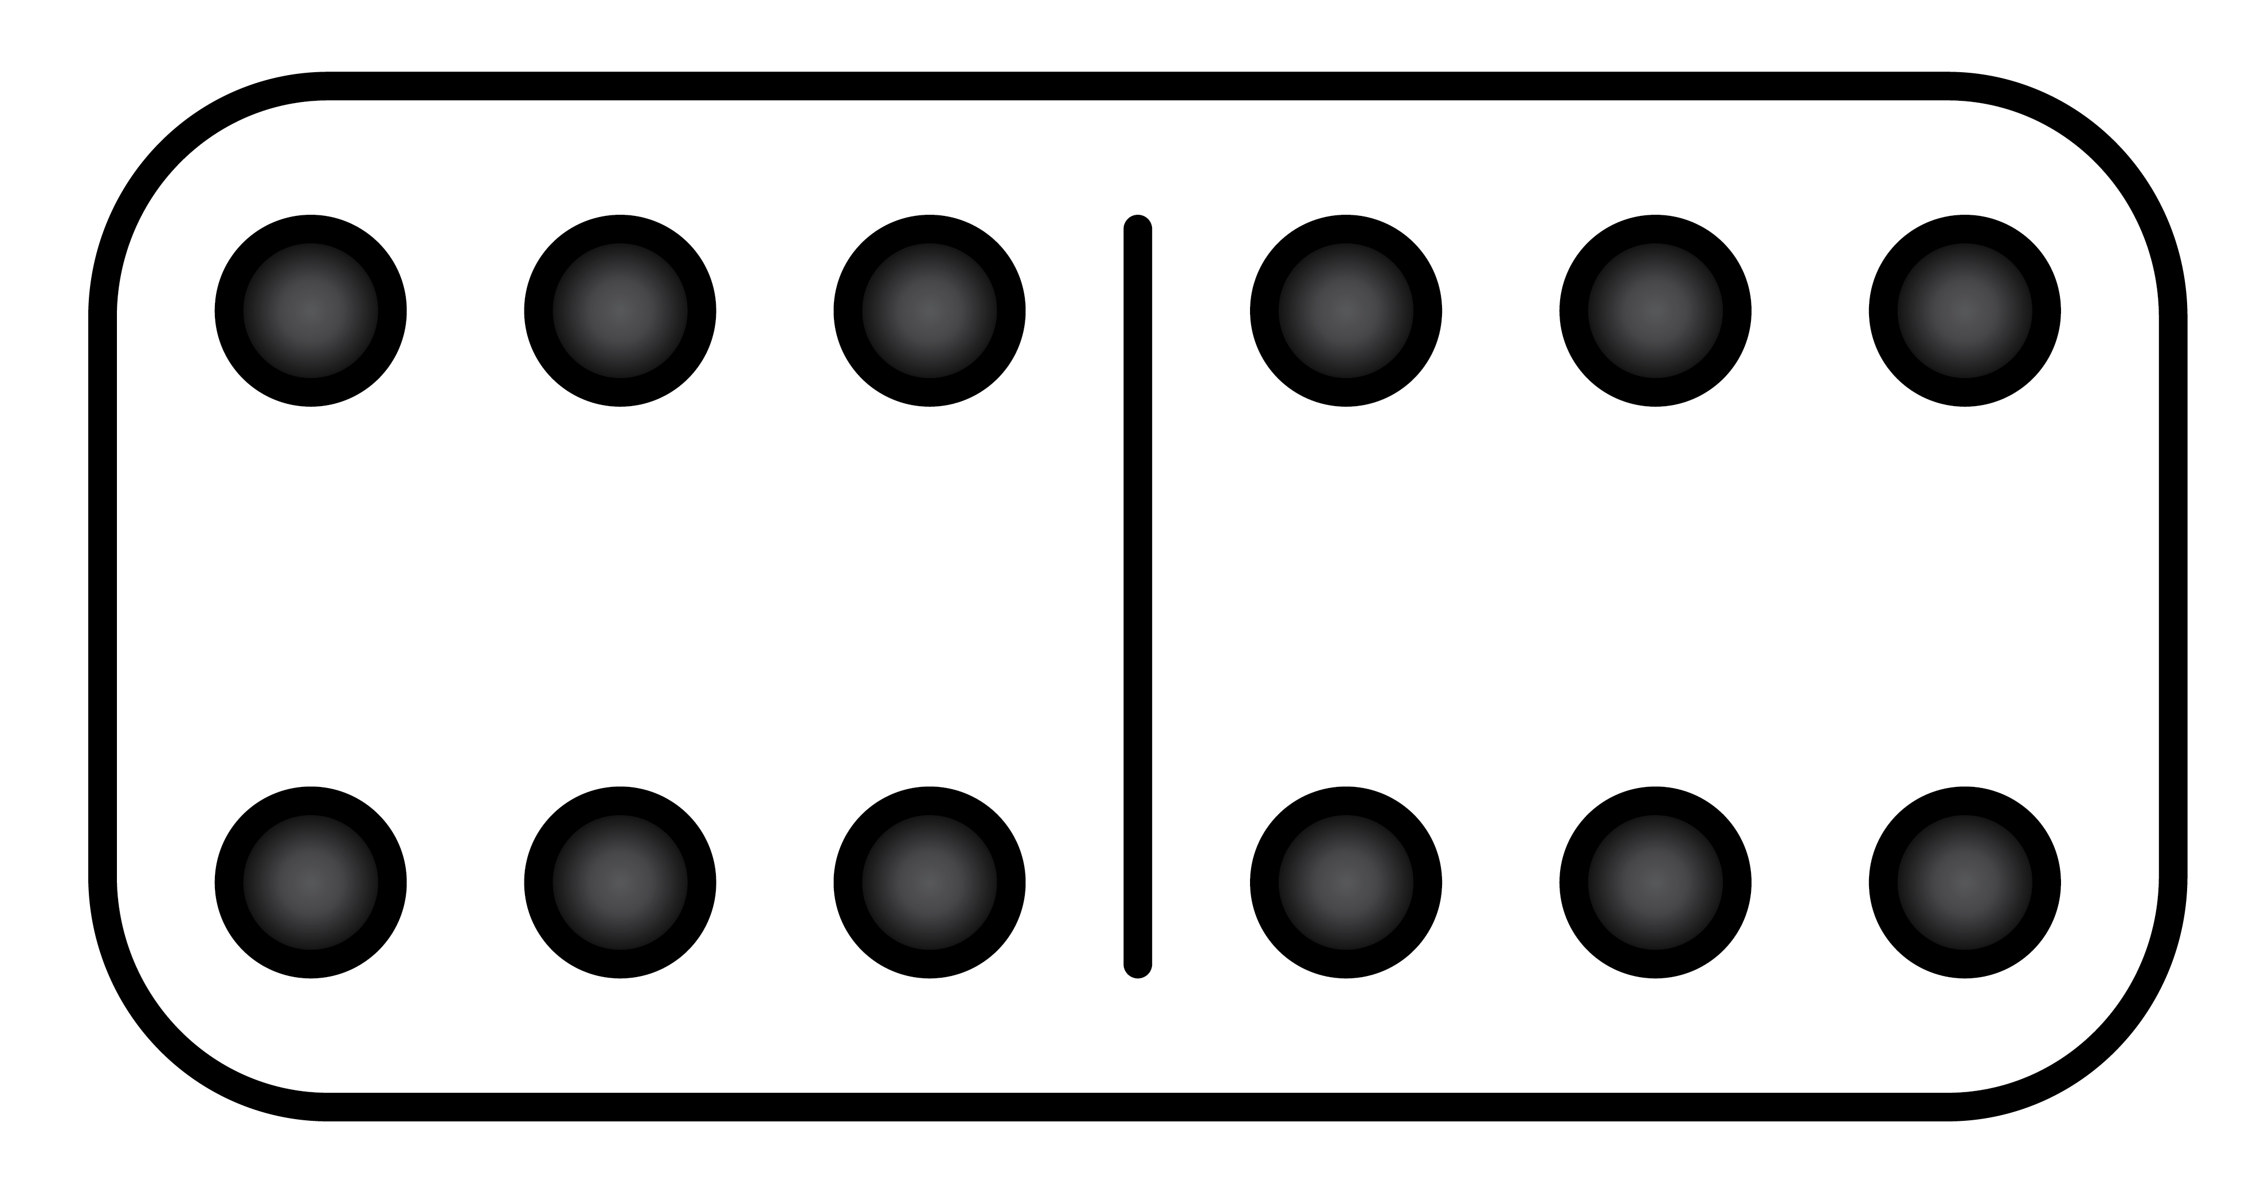
Same or Different?
What do you notice is the same about these pictures? What do you notice is different?
1
2
3
4

Slide 4
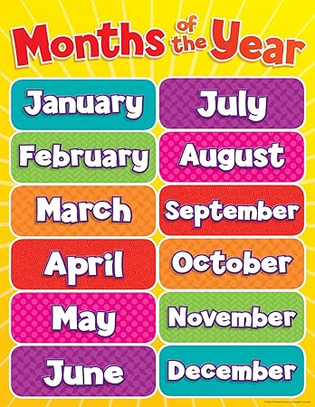
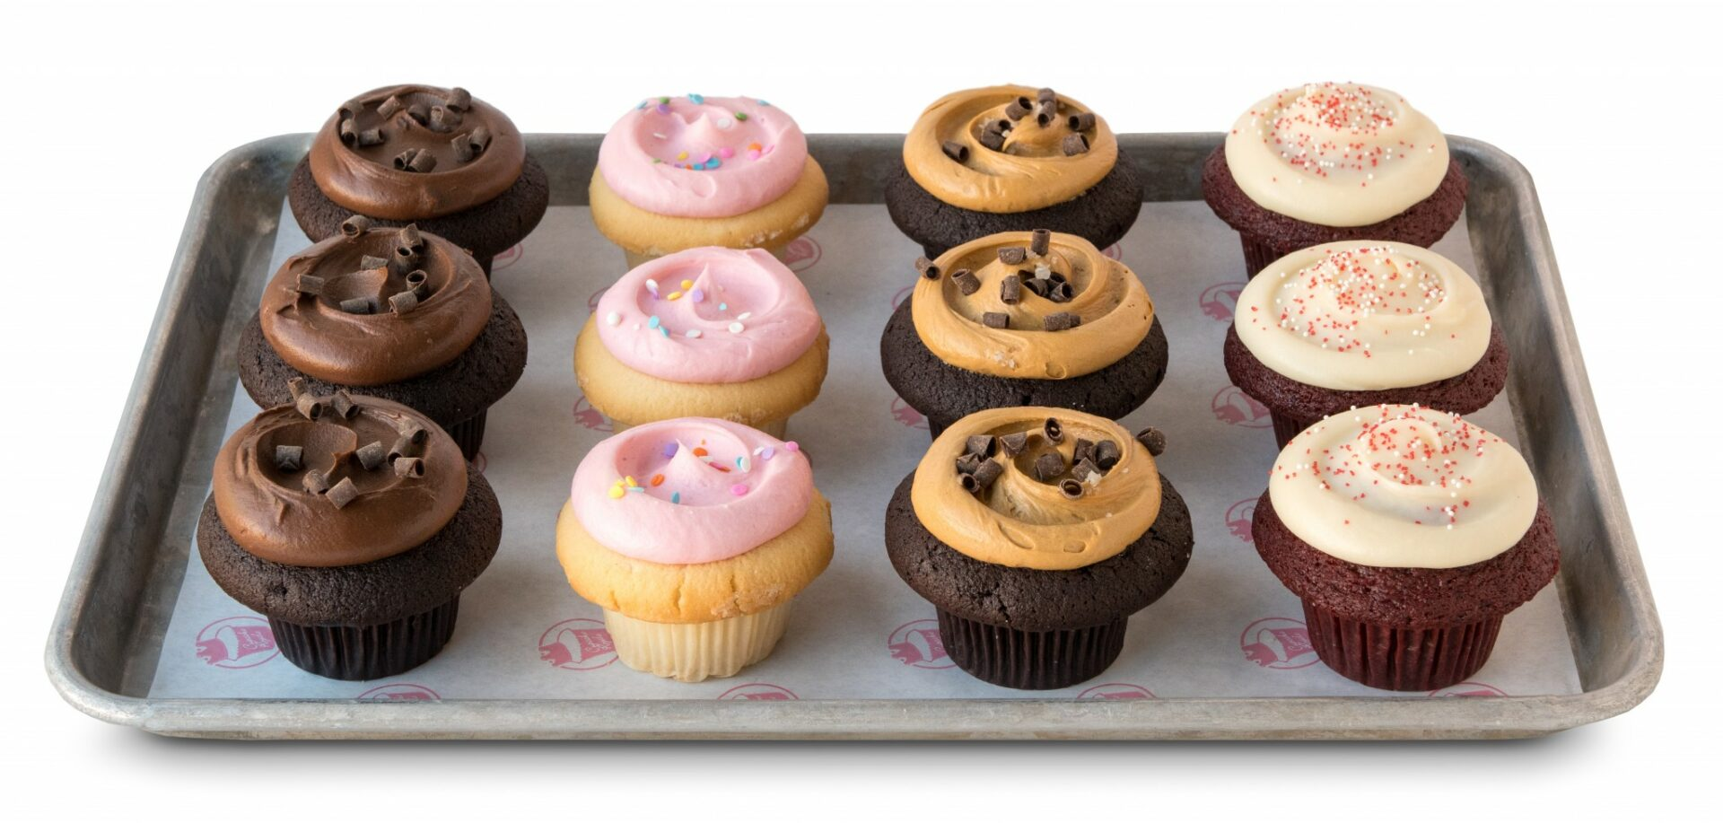
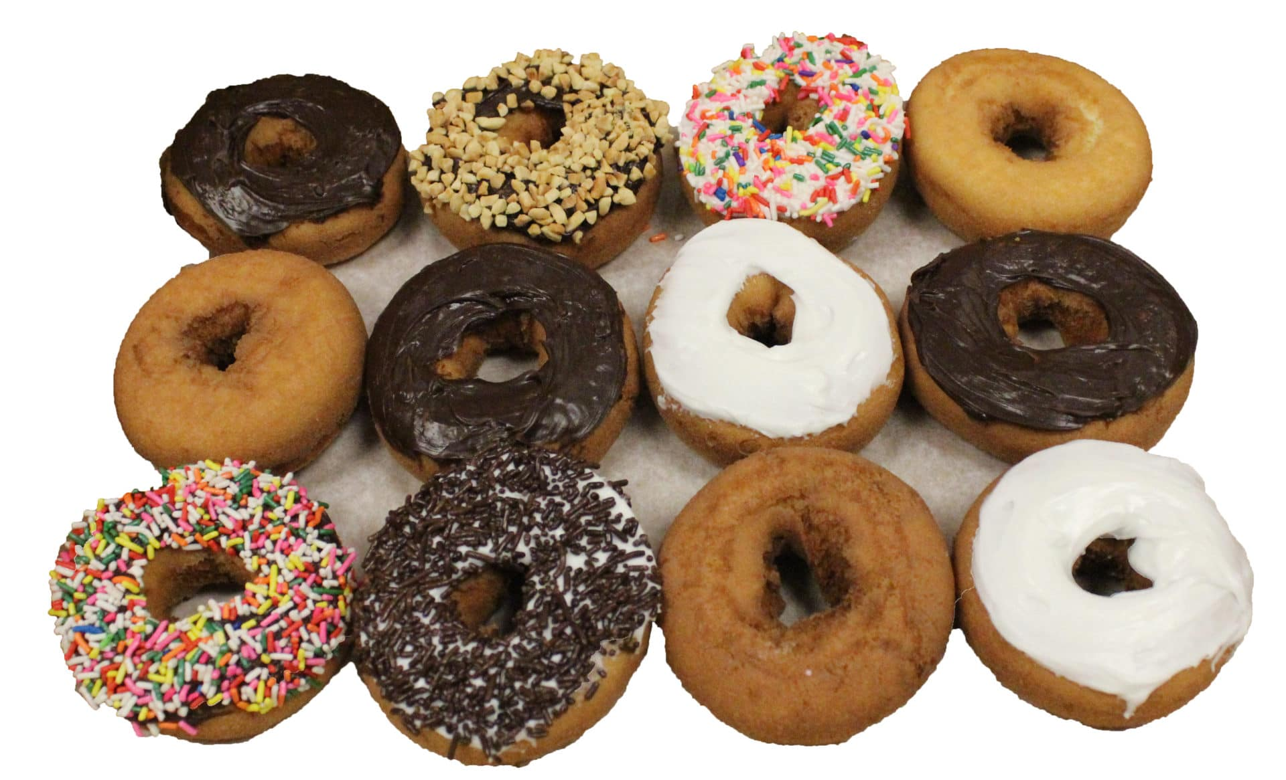
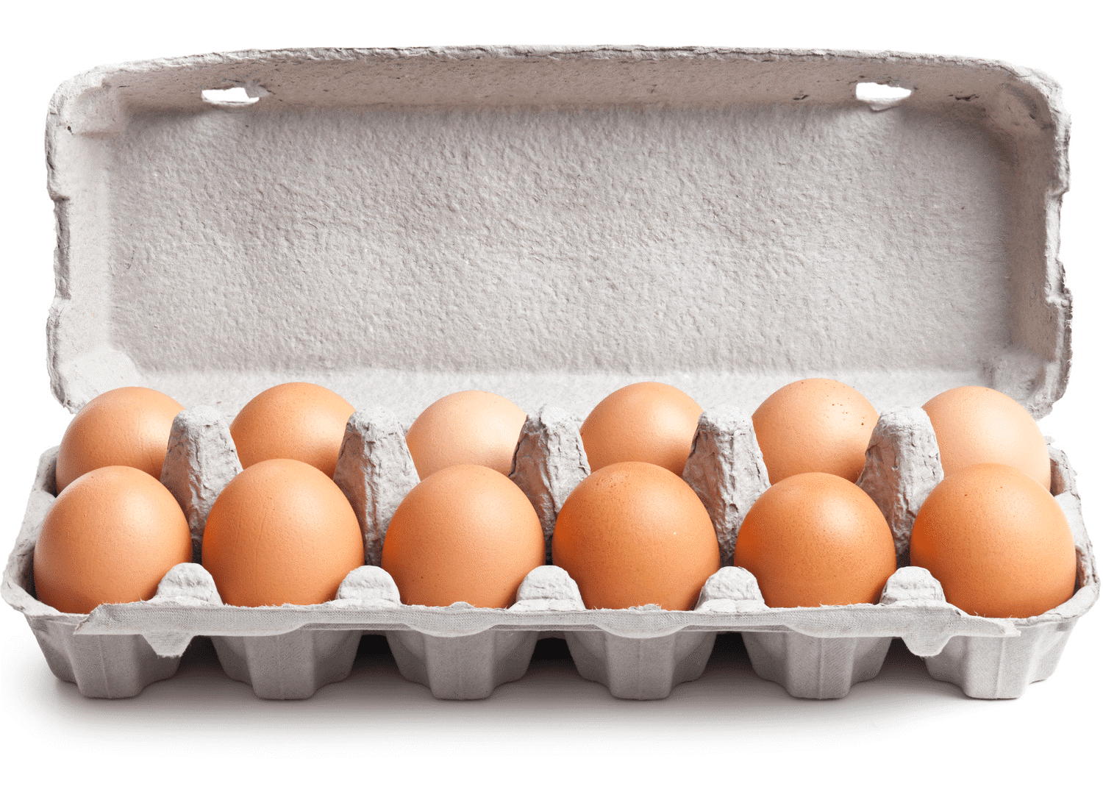
Where do we see twelve? Encourage students to be very specific.
Notes:
Discuss the term “a dozen”.

Slide 5
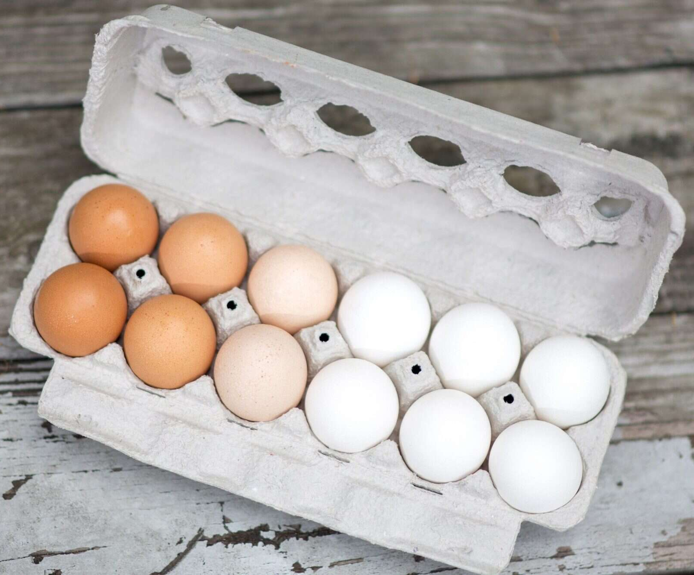
What do you notice?
What do you wonder?
How many?
How do you see it?

Slide 6
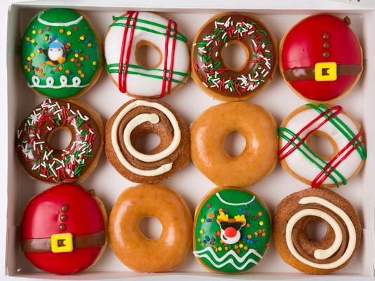
What do you notice?
What do you wonder?
How many?
How do you see it?

Slide 7
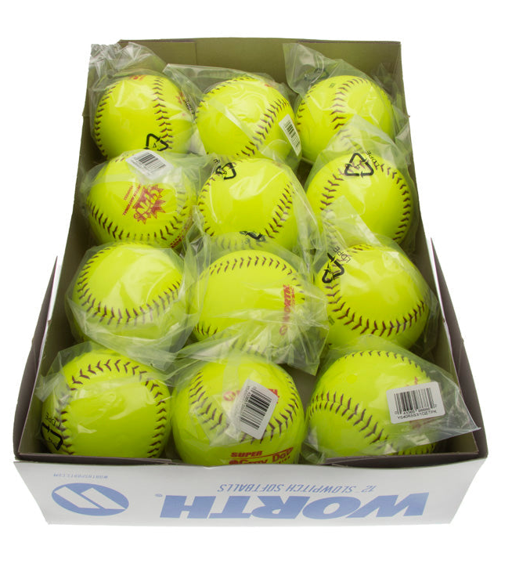
What do you notice?
What do you wonder?
How many?
How do you see it?

