Slide 1
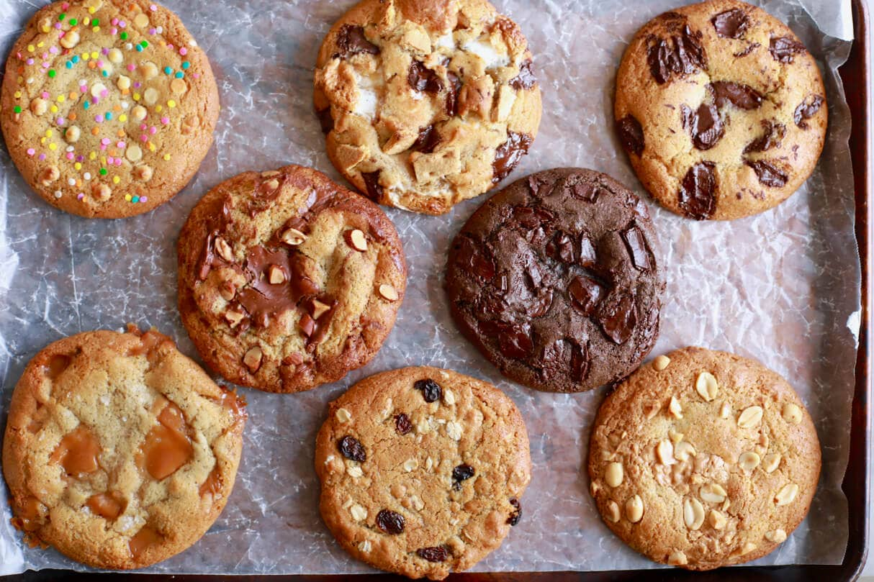
What do you notice?
What do you wonder?
How many?
How do you see it?

Slide 2
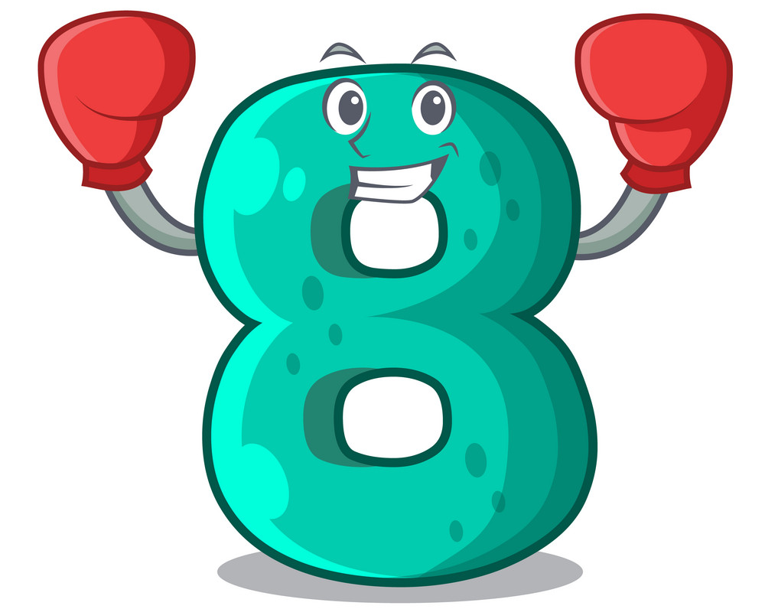
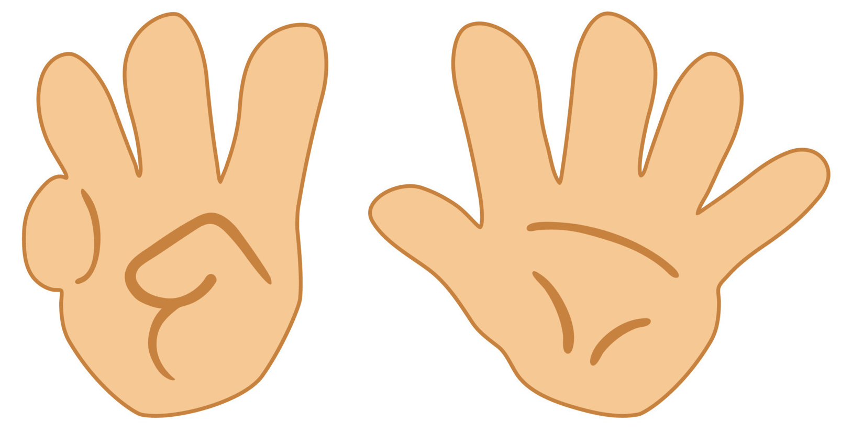
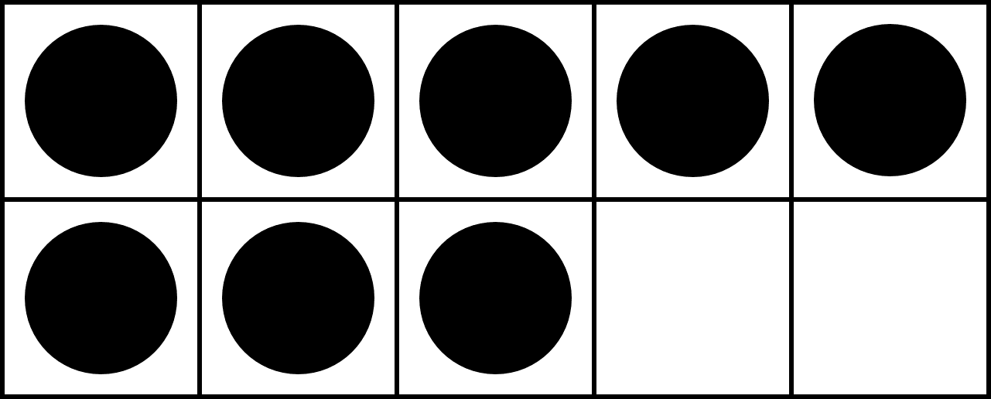
Same or Different?
What do you notice is the same about these pictures? What do you notice is different?

Slide 3
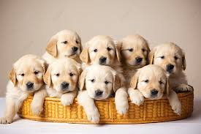
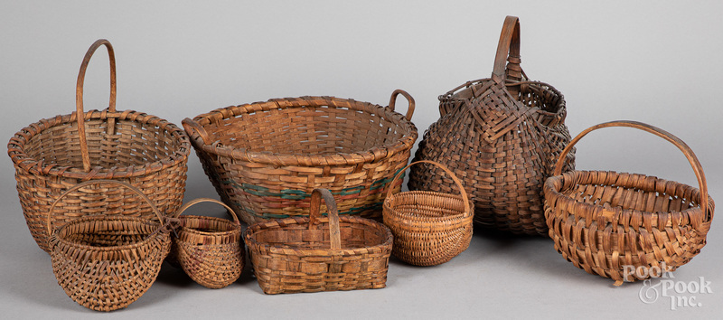
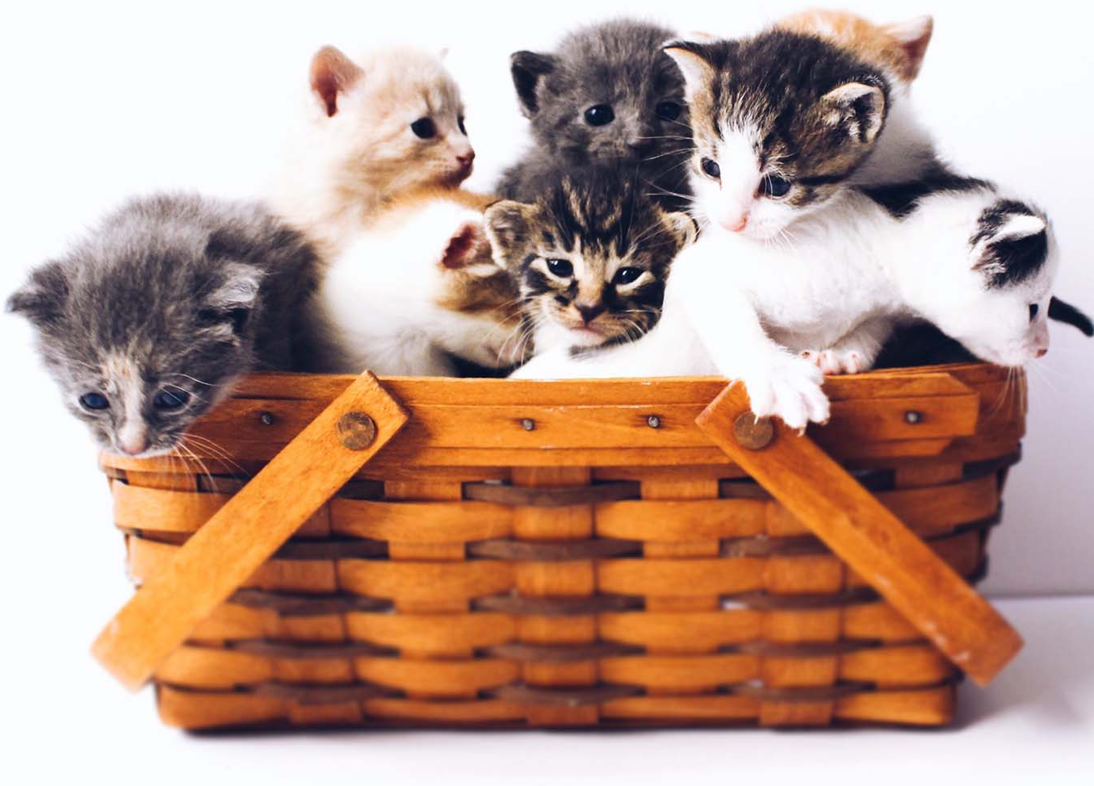
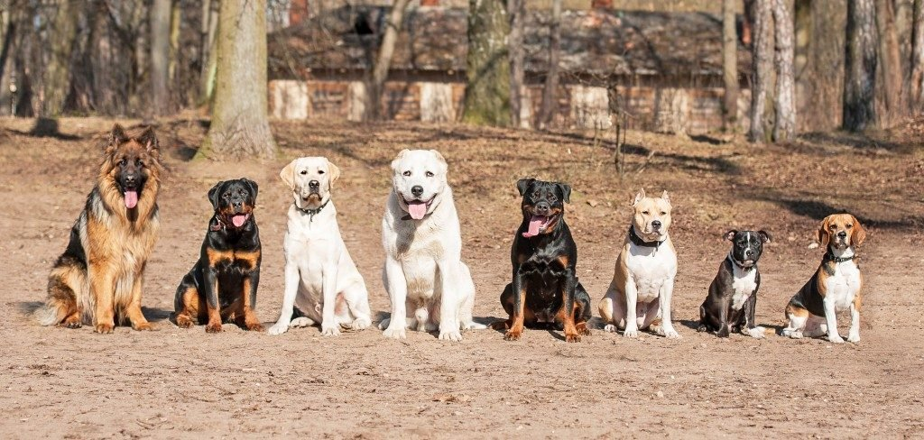
Which one of these pictures doesn't belong?
Why?
1
2
3
4

Slide 4
Eight
Which picture makes it easy to see eight without counting? Why?
1
2
● | ● | ● | ● | ●
● | ● | ●
3
4

Slide 5
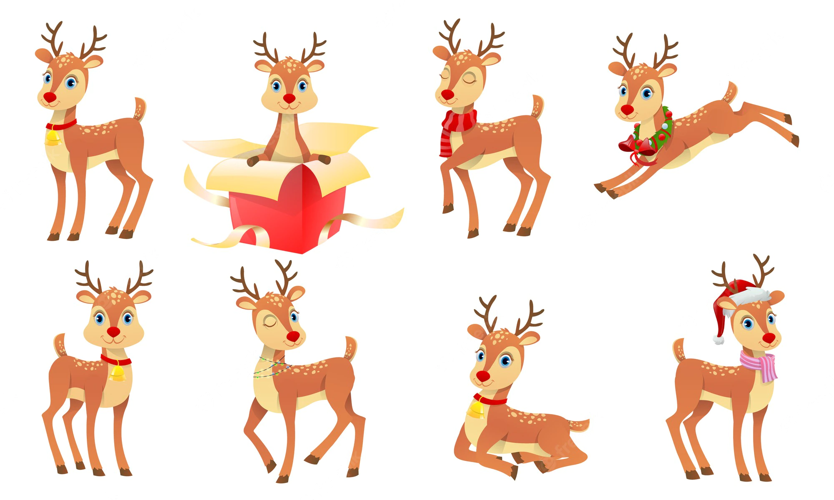
What do you notice?
What do you wonder?
How many?
How do you see it?

Slide 6
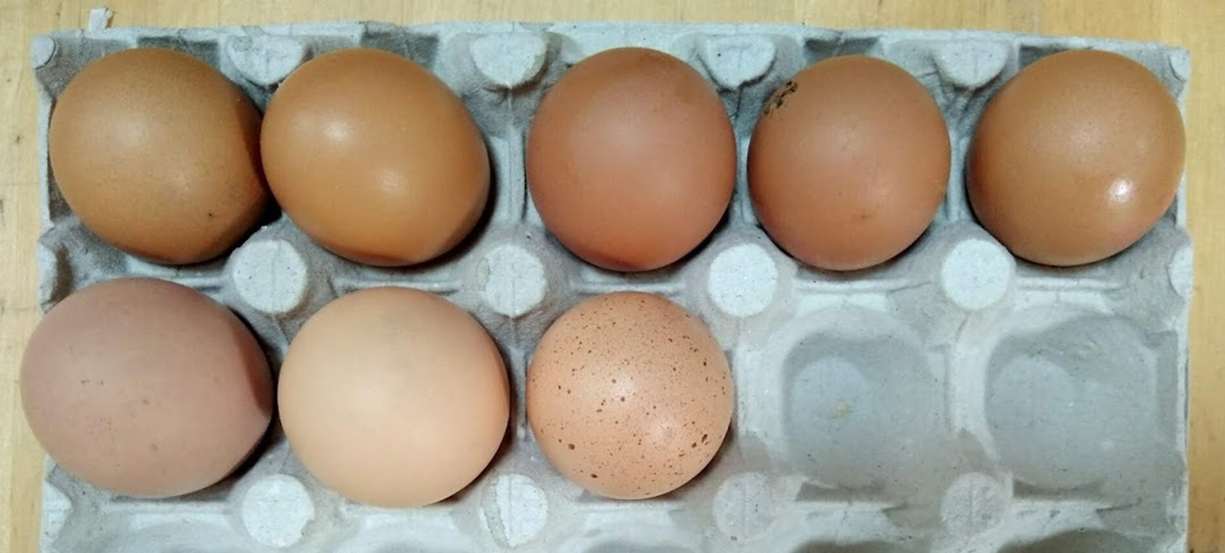
What do you notice?
What do you wonder?
How many?
How do you see it?

