Slide 1
Same or Different?
What do you notice is the same about these pictures? What do you notice is different?

Slide 2
What do you notice?
What do you wonder?
How many?
How do you see it?

Slide 3
What do you notice?
What do you wonder?
How many?
How do you see it?

Slide 4
What do you notice?
What do you wonder?
How many?
How do you see it?

Slide 5
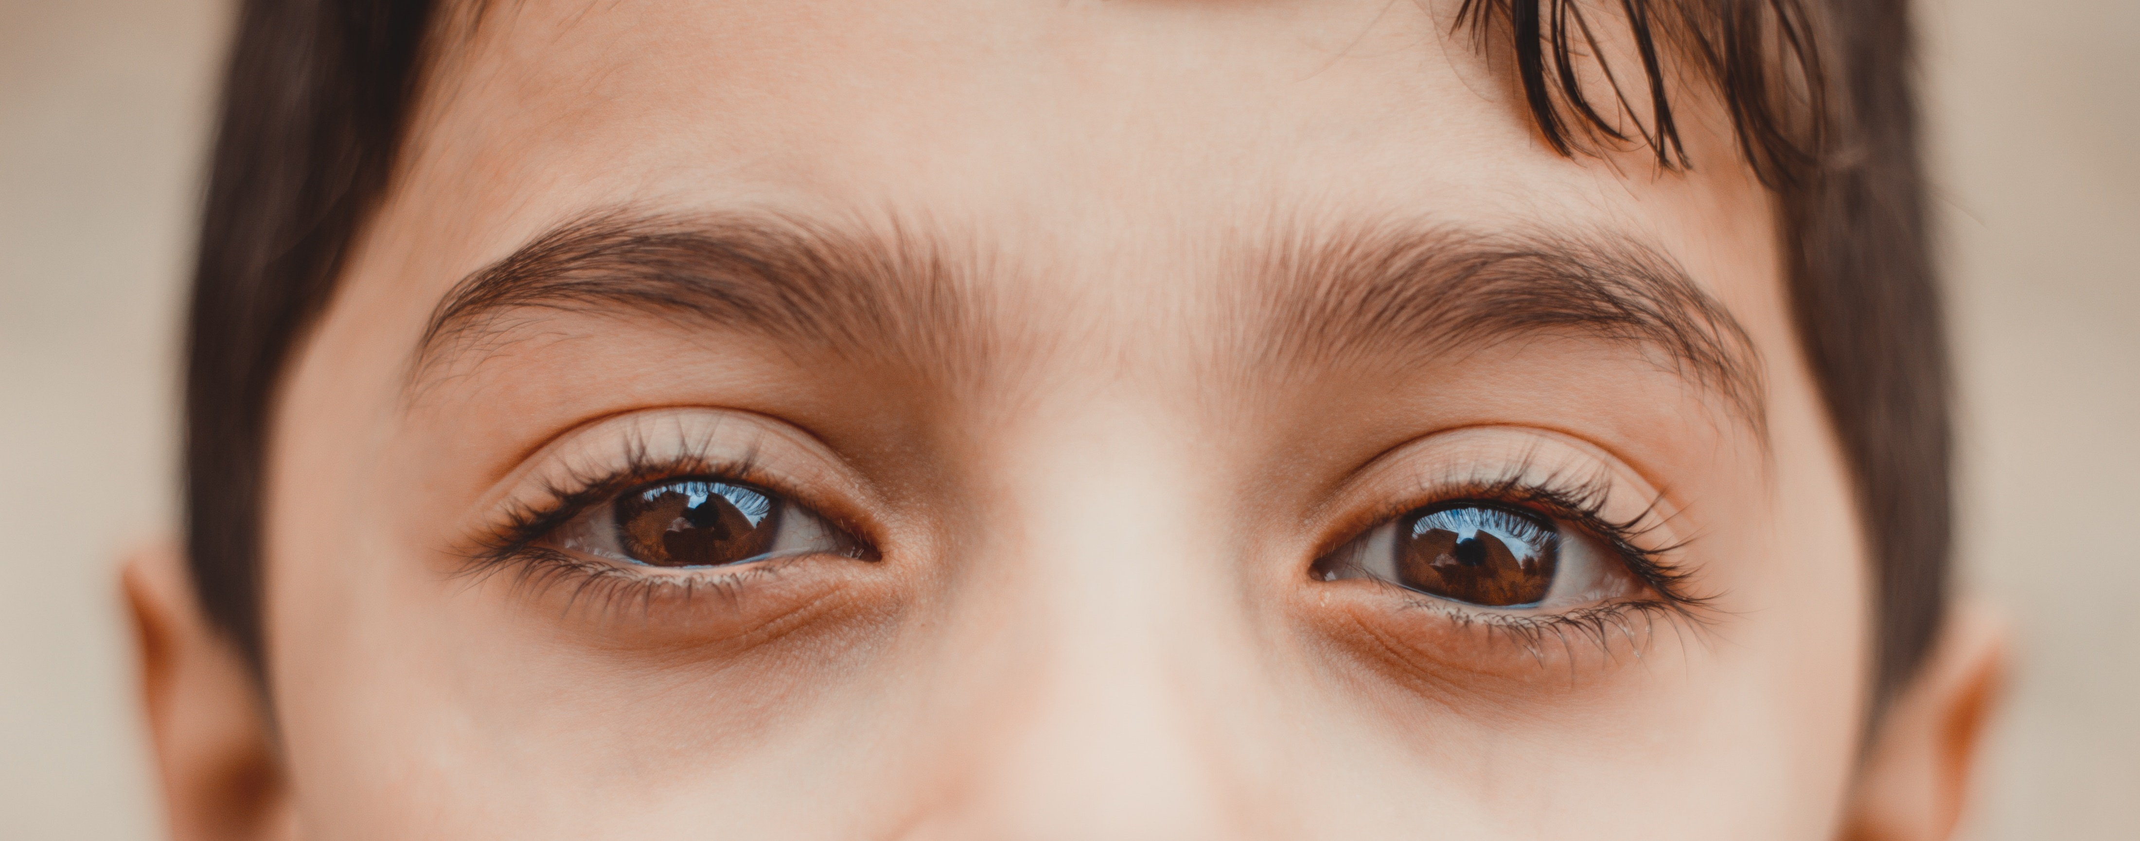
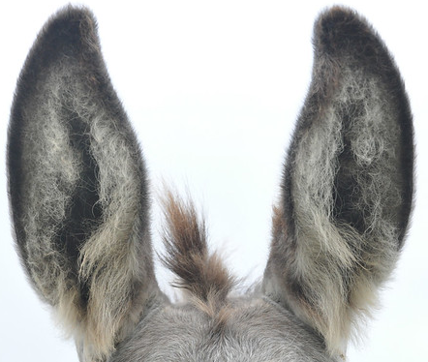
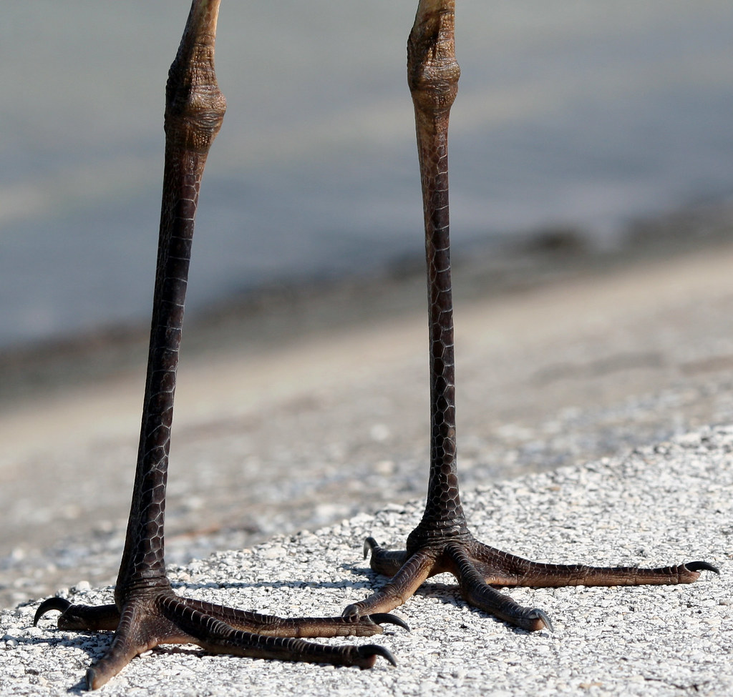
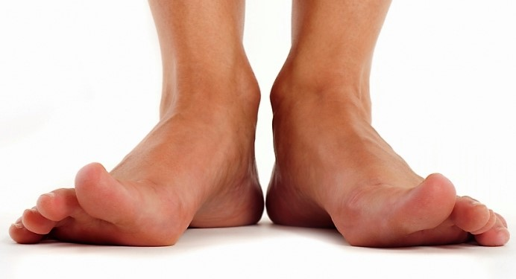
Where do we see two?
Encourage students to be very specific.
This Photo by Unknown Author is licensed under CC BY-NC

