Slide 1
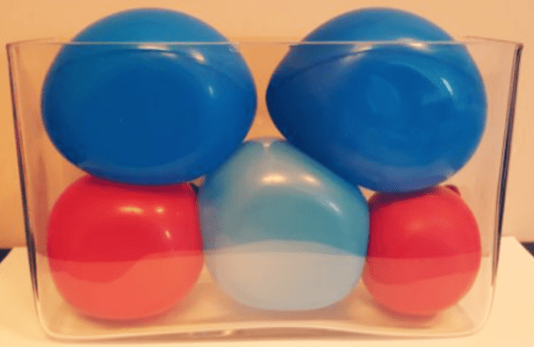
What do you notice?
What do you wonder?
How many?
How do you see it?

Slide 2
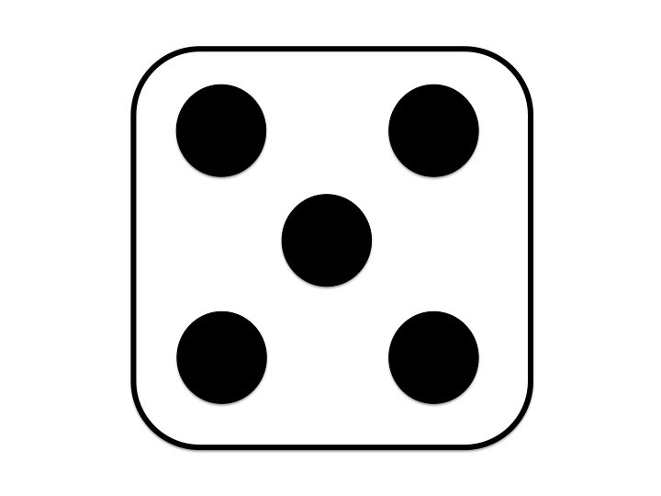
Same or Different?
What do you notice is the same about these pictures? What do you notice is different?
1
2
3
4

Slide 3
Five
Which picture makes it easy to see five without counting? Why?
● | ● | ● | ● | ●

Slide 4
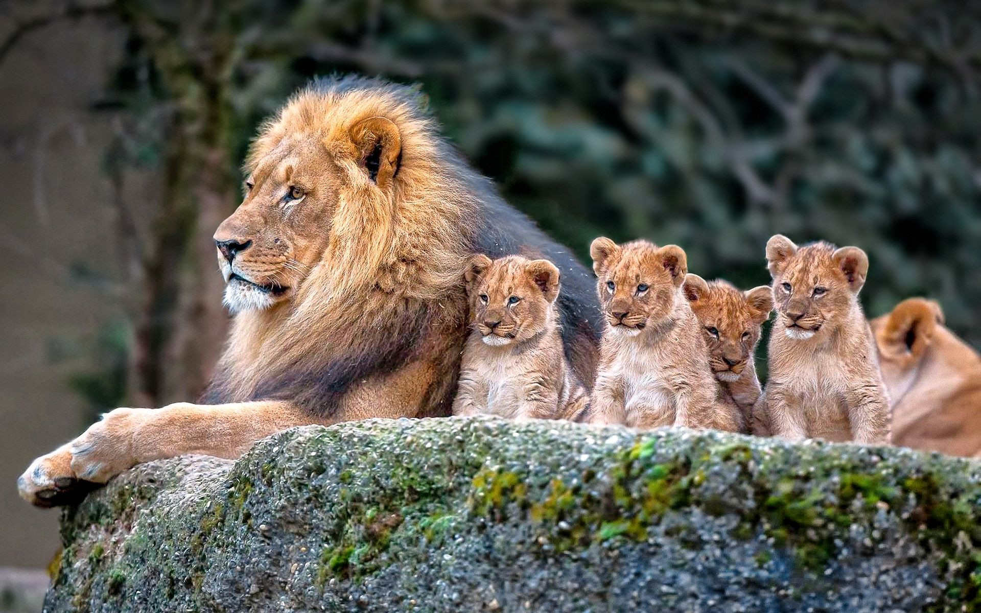
Which one of these pictures doesn't belong?
Why?
1
2
3
4

Slide 5
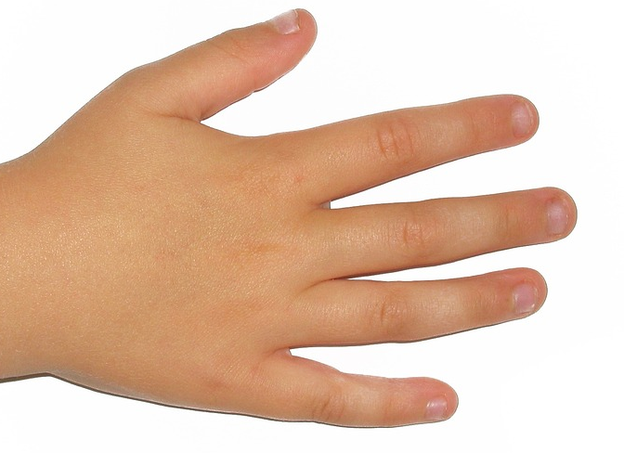
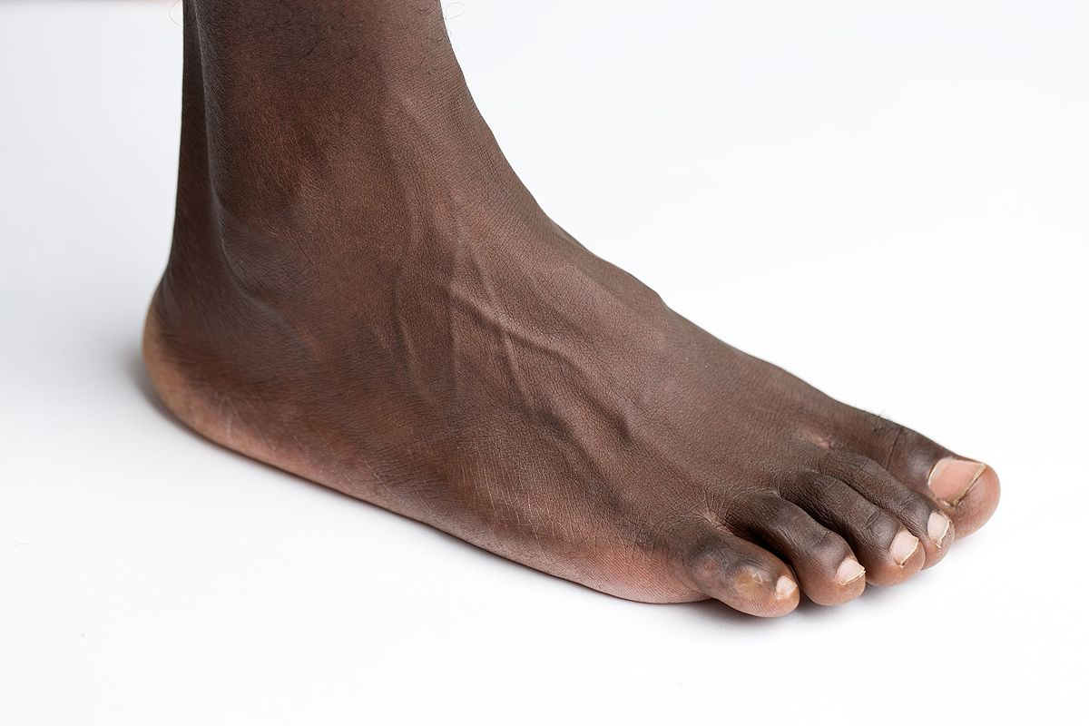
Where do we see five? Encourage students to be very specific.

Slide 6
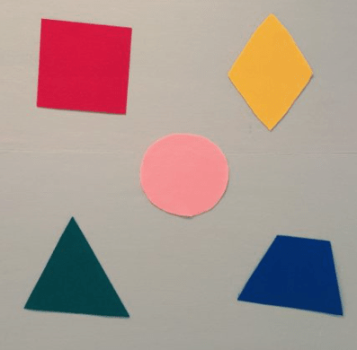
What do you notice?
What do you wonder?
How many?
How do you see it?

Slide 7
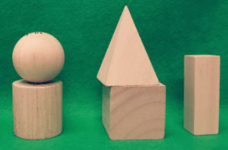
What do you notice?
What do you wonder?
How many?
How do you see it?

Slide 8
What do you notice?
What do you wonder?
How many?
How do you see it?

Slide 9
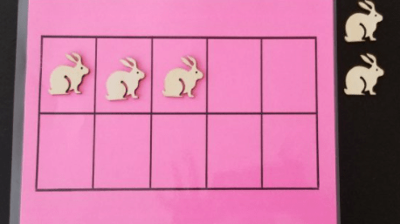
What do you notice?
What do you wonder?
How many?
How do you see it?

Slide 10
What do you notice?
What do you wonder?
How many?
How do you see it?

